Slide 1
A Measure of Disclosure Risk for Fully Synthetic Data
Mark Elliot
Manchester University
Acknowledgements:
The INI synthetic data group and specifically
Chris Dibben,
Beata Nowak and
Gillian Raab.

Slide 2
Outline
What is synthetic data?
How do we measure risk disclosure risk for synthetic data?
Desirable properties of a risk measure
An example of such a measure

Slide 3
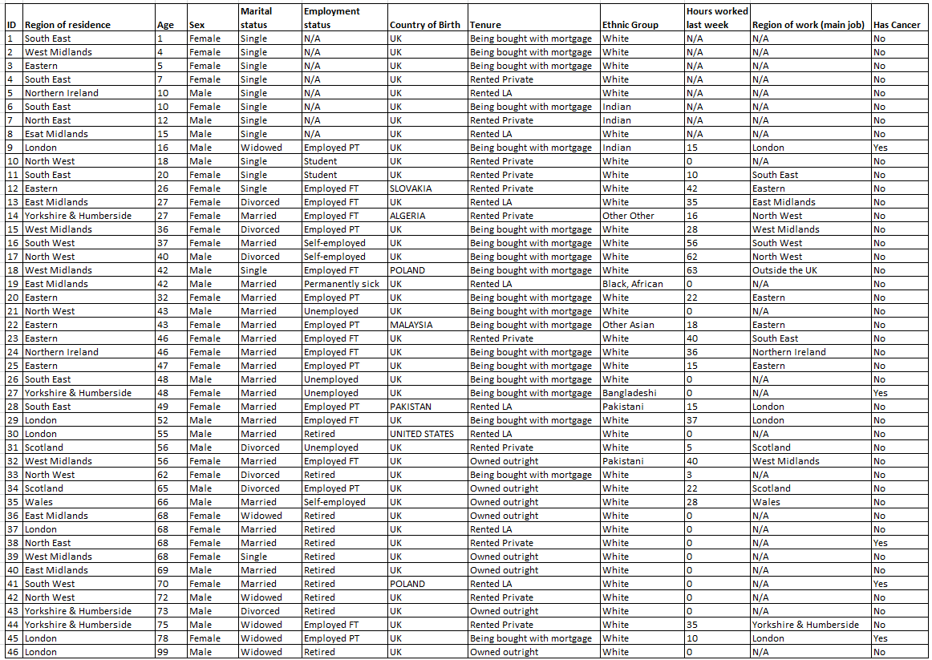
Notes:
The intention with this exercise is that this a snapshot view of a large population dataset. It is not the entire dataset.
One might do this exercise to think about what features one might need to focus on if one was disclosure controlling the data rather allowing access to the data and then controlling the output.

Slide 4
Two processes
Subjective
$$p\left(identification\right)=p(attempt)×p(identification|attempt)$$
Objective

Slide 5
What is synthetic data?
Synthetic data Production
Model
Useable synthetic/ disclosure controlled data
Disclosure Control
Random
Data
Original
Data
Fully
Saturated
Model
Pure
Noise

Slide 6
What is synthetic data?
Useable synthetic/ disclosure controlled data
Random
Data
Original
Data
Fully
Saturated
Model
Pure
Noise
Negligible identification risk but empirical attribution risk
Non Negligible identification risk
and attribution risk
Zone of plausible Inference

Slide 7
Disclosure Control for Fully Synthetic data
Naive view: Its synthetic why are you even asking this question?
Subjective element.
But if the data generation process for the synthetic data is fully saturated?
Objective element.

Slide 8
Disclosure risk and synthetic data
If the link is broken
Reidentification is meaningless
But attribution is not

Slide 9
General Approach
Strong attribute disclosure
Can I learn more about a particular individual from a synthetic dataset based on a source dataset that contains that individuals record than a dataset which does not.
Also interested in relative residuals.

Slide 10
Desired Properties
Provide a measure of attribute disclosure
Able to be based on plausible scenarios or worst cases.
Separate personalised from generalised inference

Slide 11
Approach for the Sylls evaluation project
Test data set
2011 Living Conditions and Food survey
Synthetic versions of the 2010, 2011, 2012 surveys.

Slide 12
Principles
Generate a risk measure for a given record based on the
Probability of accurate attribution (for categorical targets).
Residuals of estimated values (for continuous targets).
Non-parametric methodology

Slide 13
By record attribute risk procedure assuming a categorical target variable
Obtain two consecutive years of the same survey dataset.
Generate synthetic versions of those data sets.
Take a record r at random from the original dataset and using a predefined key (K).
Match r back onto the original dataset (O)
Match r against the synthetic version of O (S)
Match r against the synthetic dataset for the other year (S’)
Select a target variable T
Each of 3 a-c will produce a match set (a set of records which match r).
The proportion of each match set with the correct value on T is the probability of an accurate attribution (PAA) value for that match set.
Repeat 4 and 5 several times with different targets
Repeat 3-6 with different records until the PAA values stabilise.

Slide 14
General procedure assuming a categorical target variable
For each record in O record their multivariate class membership for both K and K+T.
The equivalence class for K+T divided by the equivalence class for K for a given record will be the PAA for that record.
Repeat 1 for each record in S. Impute the PAA values from S into O against the corresponding records (matched on K+T).
Repeat 2 for S’

Slide 15
General procedure assuming a continuous target variable
For each record in O
record their multivariate class membership for K.
For each equivalence class, calculate $\overline{T}$.
For each record calculate the residual (between and T$and \overline{T}$).
Repeat 1 for S. Impute the residual values from S into O.
Repeat 2 for S’

Slide 16
Key variables
Key 1: GOR, Output area classifier,
Key 2: GOR, Output area classifier, tenure.
Key 3: GOR, Output area classifier, tenure, dwelling type.
Key 4: GOR, Output area classifier, tenure, dwelling type, Internet in household.

Slide 17
Example residuals for saturated model predicting income for a single case

Slide 18
Mean Probability of accurate attribution(PAA) of economic position of household reference person
File | Key 1 | Key 2 | Key 3 | Key 4 | mean cumulative key impact
2011 original | 0.35 | 0.59 | 0.72 | 0.78 | 0.14
2010 synth | 0.31 | 0.31 | 0.23 | 0.20 | -0.04
2011 synth | 0.31 | 0.34 | 0.26 | 0.23 | -0.03
2012 synth | 0.31 | 0.31 | 0.24 | 0.21 | -0.03
baseline | 0.26 | 0.26 | 0.26 | 0.26
synth2011-baseline | 0.05 | 0.08 | 0.00 | -0.03
Mean Differential | 0.00 | 0.03 | 0.03 | 0.03

Slide 19
Mean Probability of accurate attribution (PAA) of economic position of household reference person given that a match has occurred.
File | Key 1 | Key 2 | Key 3 | Key 4 | mean cumulative key impact
2011 original | 0.35 | 0.59 | 0.72 | 0.78 | 0.14
2010 synth | 0.37 | 0.45 | 0.45 | 0.49 | 0.04
2011 synth | 0.33 | 0.44 | 0.45 | 0.48 | 0.05
2012 synth | 0.33 | 0.40 | 0.42 | 0.44 | 0.04
baseline | 0.26 | 0.26 | 0.26 | 0.26
synth2011-baseline | 0.06 | 0.17 | 0.18 | 0.21
Mean Differential | -0.02 | 0.02 | 0.02 | 0.01

Slide 20
Mean PAA scores over 3 categorical targets across four keys of increasing size.

Slide 21
Hit rate for primary key matches from the original file onto the synthetic file.
File | Key 1 | Key 2 | Key 3 | Key 4 | mean cumulative key impact
2011 original | 100% | 100% | 100% | 100% | 0%
2010 synth | 84% | 69% | 51% | 41% | -14%
2011 synth | 95% | 77% | 58% | 48% | -16%
2012 synth | 94% | 78% | 57% | 48% | -15%
Mean Differential | 6% | 3% | 3% | 4%

Slide 22
Table 10: Residual sizes for estimated weekly income using two keys against the LCF and three synthetic files
File | Key 1 | Key 2 | Key 3 | Key 4 | mean cumulative key impact
2011 original | 246 | 246 | 174 | 147 | -33.24
2010 synth | 401 | 378 | 396 | 397 | -1.19
2011 synth | 369 | 368 | 384 | 380 | 3.76
2012 synth | 376 | 374 | 389 | 387 | 3.75
baseline | 385 | 385 | 385 | 385
synth2011- baseline | -15 | -17 | 0 | -4
Mean Differential | 19 | 7 | 8 | 11

Slide 23
Concluding remarks
This approach to measuring disclosure risk looks promising.
Future work
Intruder strategies – optimising key size
Testing with disclosure controlled data
Investigating the impact of risky records
Testing with a wider range of synthetic data
Particular those produced using a DP mechanism
Understanding the relationship with utility
Building the measure into GA built synthetic data

