Slide 1

Tackling new diseases
Intervention choices: what are the issues?
Isaac Newton Institute Webinar, 11 September 2020
Salim S. Abdool Karim, FRS
Director: CAPRISA
CAPRISA Professor of Global Health, Columbia University
Chair: Ministerial Advisory Committee on COVID-19
Member: African Task Force for Coronavirus
Pro Vice-Chancellor (Research): University of KwaZulu-Natal
Adjunct Professor in Immunology and Infectious Diseases, Harvard University
Adjunct Professor of Medicine: Cornell University
Director: DST-NRF Centre of Excellence in HIV Prevention

Slide 2
Outline
Learning from the past….
….. to better prepare interventions for future pandemics
Drawing on epidemic experiences in Africa
  Ebola
  HIV
  Covid-19
Key lessons on interventions for future pandemics
Intervention choices
Planning for a marathon, not a sprint
Conclusion - Five key lessons from epidemics in Africa

Slide 3
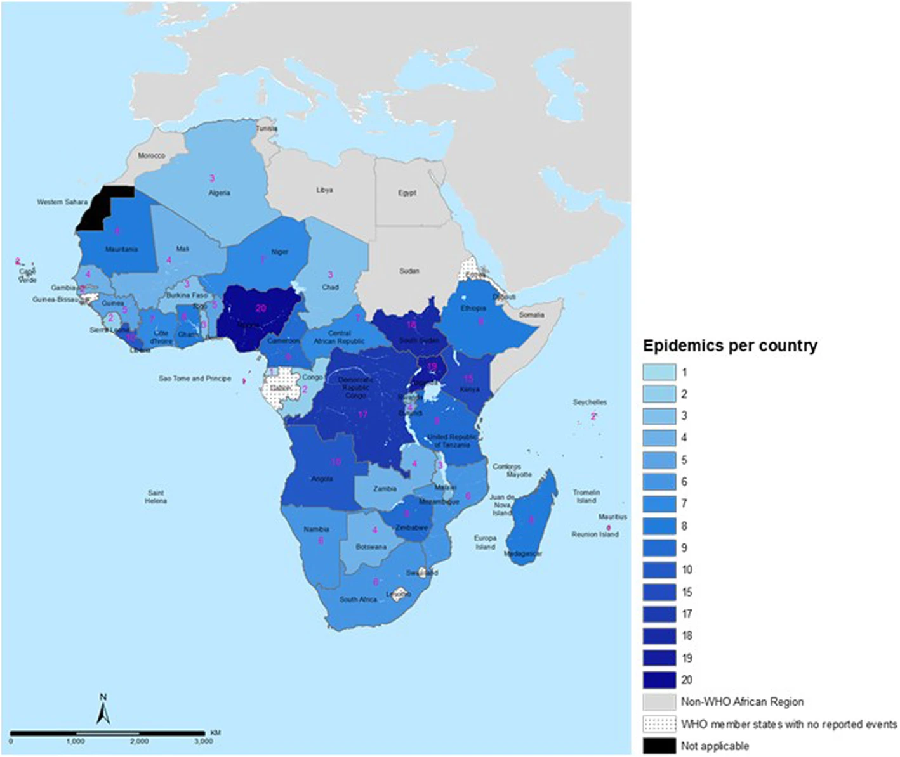
Epidemics in Africa:
What have we learnt from
Ebola, HIV & Covid-19?
What lessons for future pandemics?
Number of epidemics and other public health emergencies in the WHO African region, 2016–2018
Source: Talisuna, A.O., et al. Spatial and temporal distribution of infectious disease epidemics, disasters and other potential public health emergencies in the World Health Organisation Africa region, 2016–2018. Global Health 16, 9 (2020). https://doi.org/10.1186/s12992-019-0540-4

Slide 4
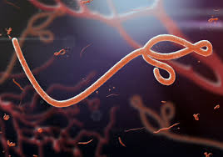
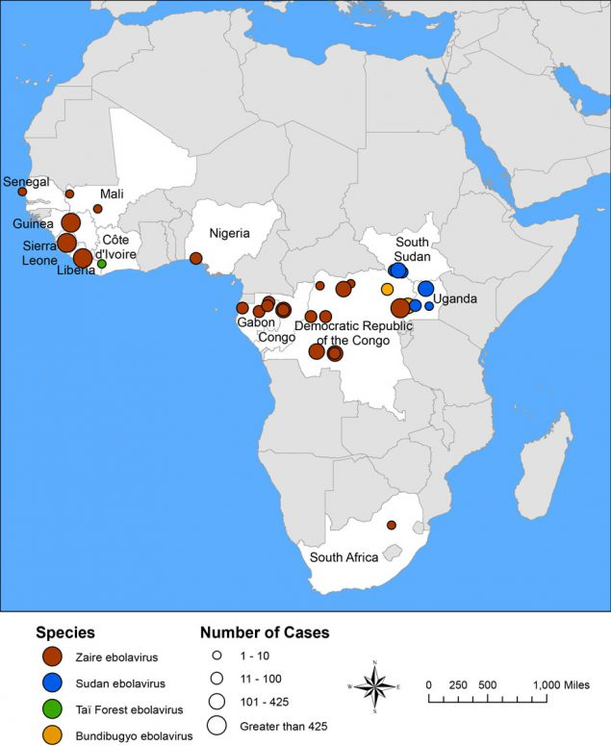
Ebola epidemics in Africa
Ebola virus: a filovirus in fruit bats, porcupines and non-human primates
2014-2016 outbreak – 28,616 cases & 11,310 deaths
Average case fatality rate: 50%
2020 outbreak in DRC – ∼100 cases and is ongoing
Ebola virus outbreaks by species and size, since 1976

Slide 5
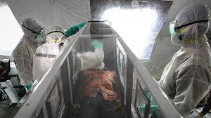

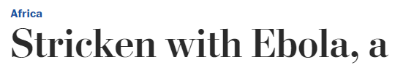

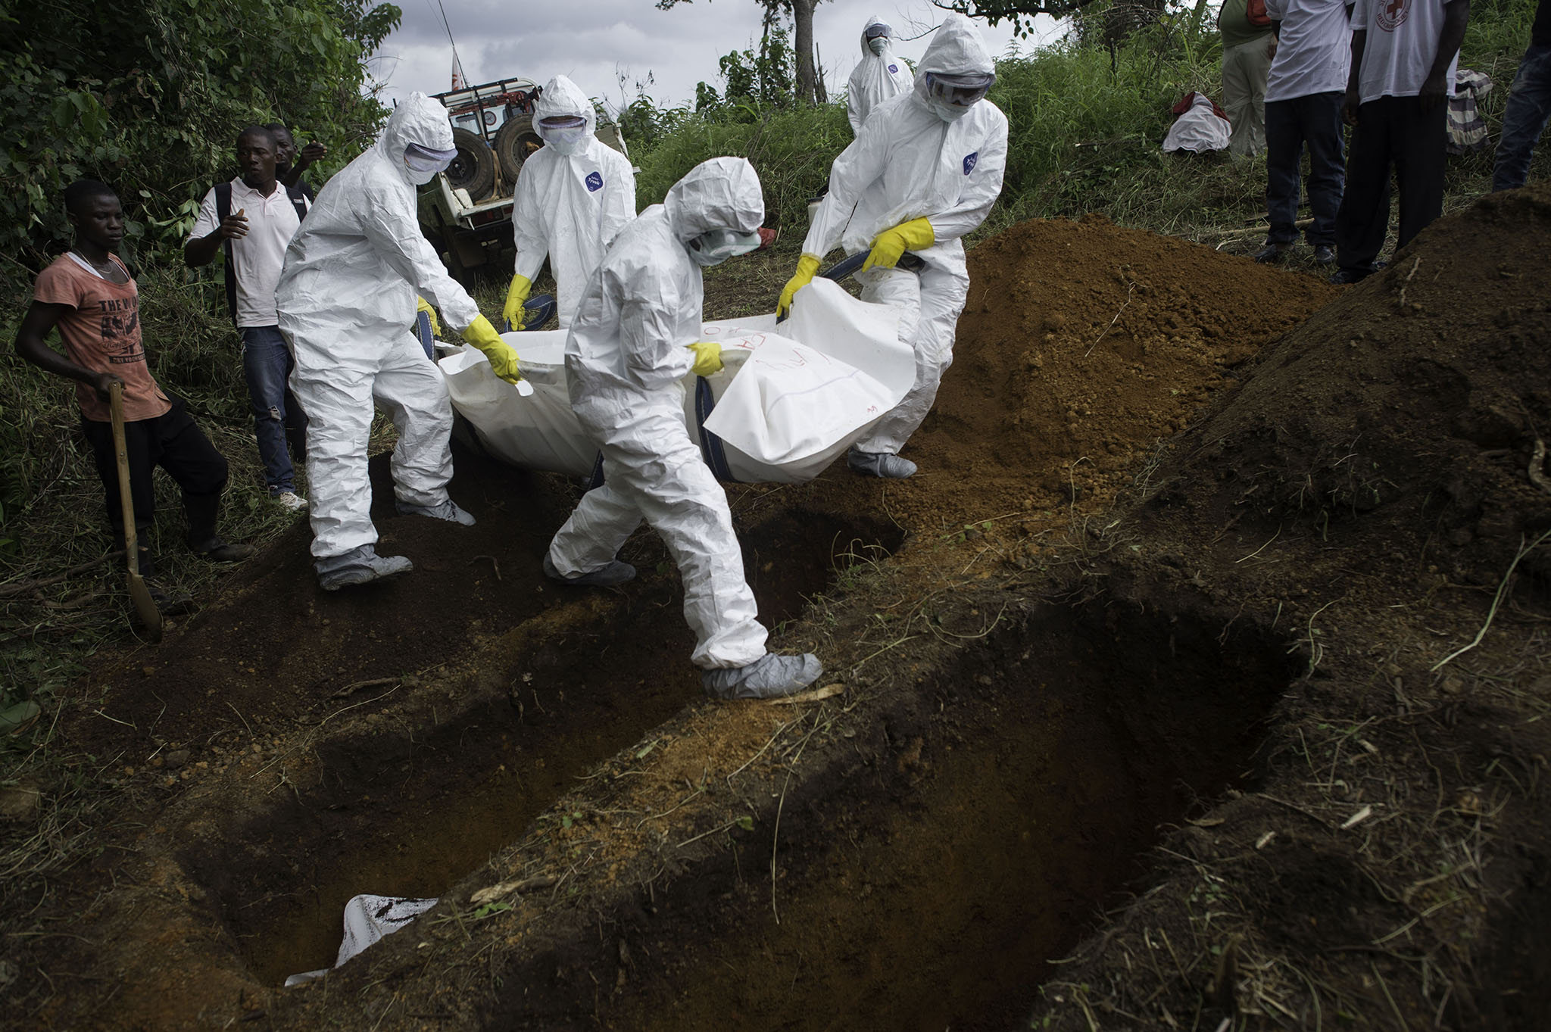
Ebola – key lessons for future pandemics
Early identification & decisive action is critical
Healthcare worker protection – high exposure- requiring PPE & proper cleaning and sterilization
Community engagement - key to successful contact tracing and control of community transmission
Comprehensive approach to outbreak control - package of interventions, including surveillance and contact tracing, laboratory services, infection prevention and control practices, case management, safe and dignified burials and social mobilisation

Slide 6
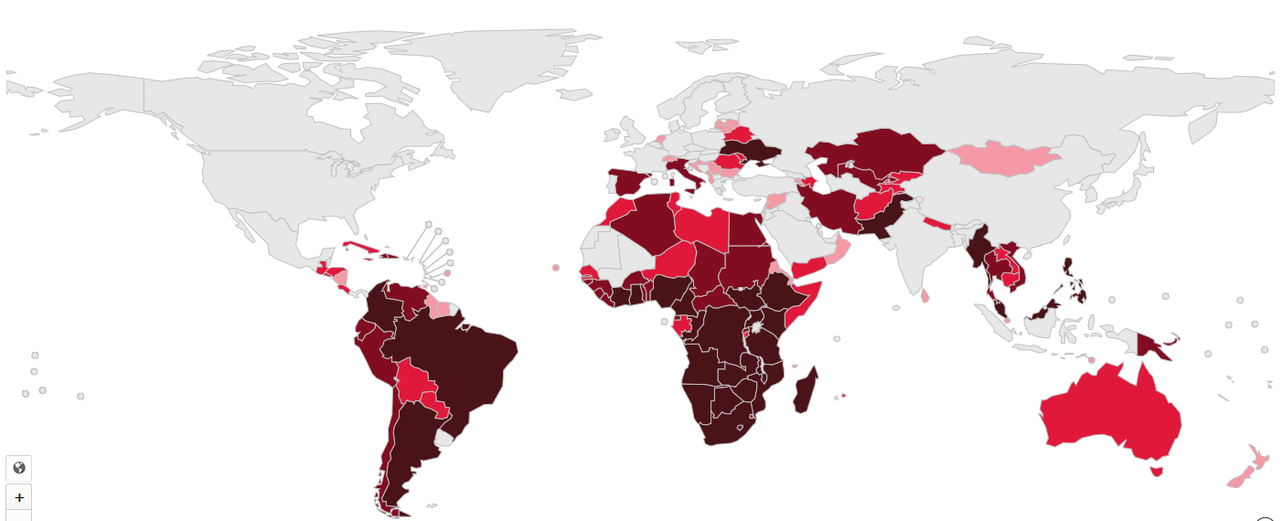

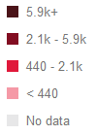
HIV epidemic in Africa
In Africa in 2019, there were:
25.6 million living with HIV (67% of global burden)
440,000 deaths (64% of global total)
970,000 new infections (57% of global total)
In sub-Saharan Africa:
- adolescent girls and young women account for 25% of all new infections
Notes:
African statistics

Slide 7

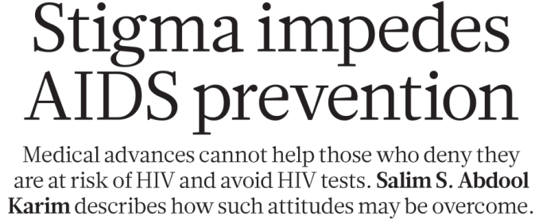
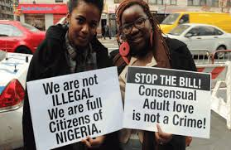
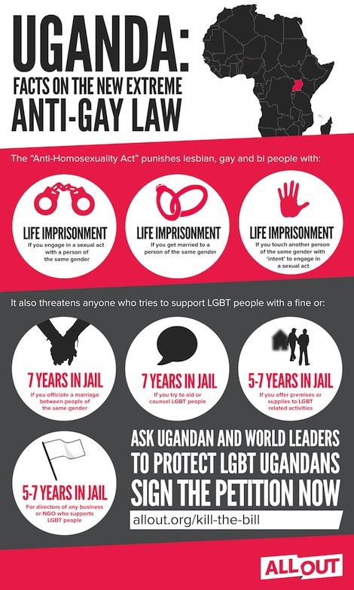
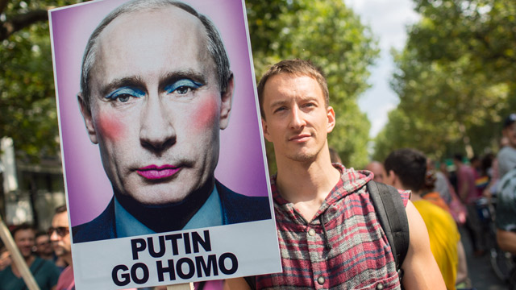
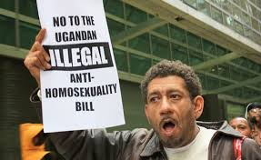
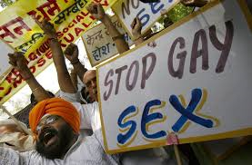



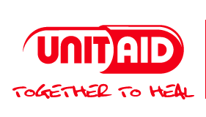
HIV – key lessons for future pandemics
Testing - rapid, reliable and affordable diagnostic test for HIV – a game changer
Human rights approach - to overcome stigma and discrimination of vulnerable groups
Community mobilization and advocacy – achieved many of the
hard-won gains in HIV
Global solidarity - access to life-saving medication, e.g. Global Fund, UNITAID, PEPFAR

Slide 8
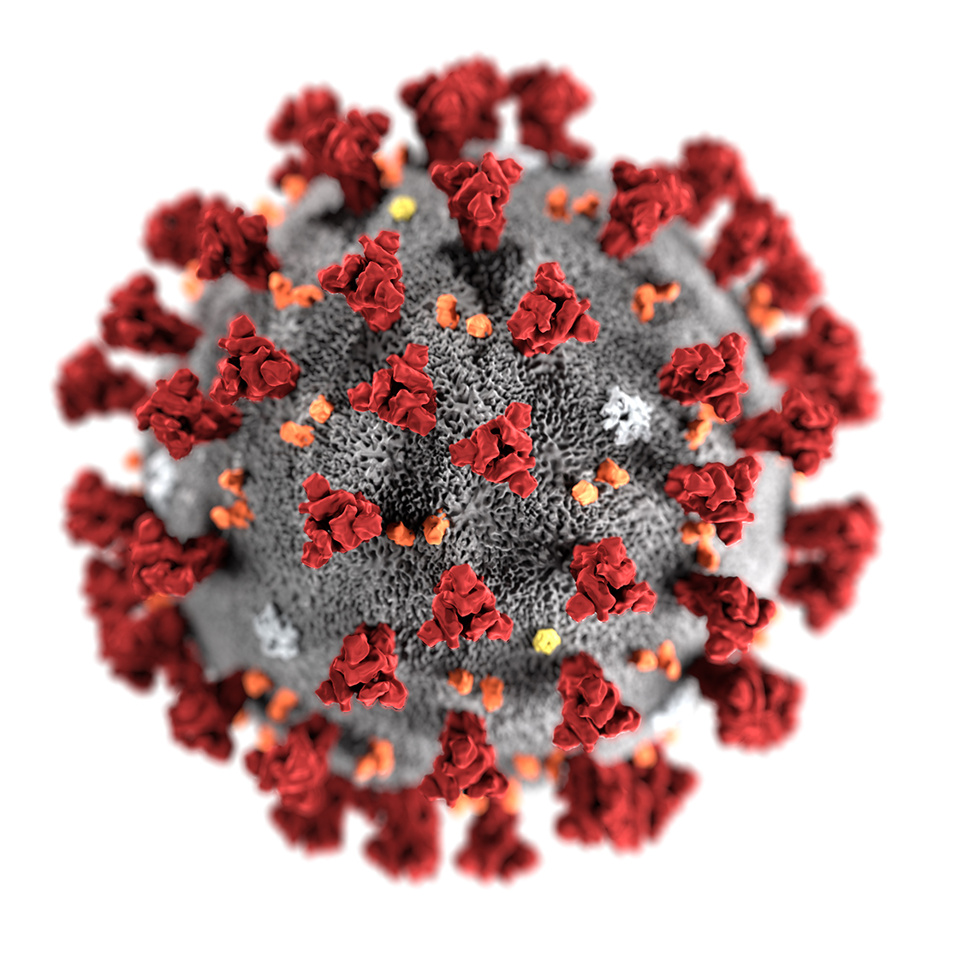
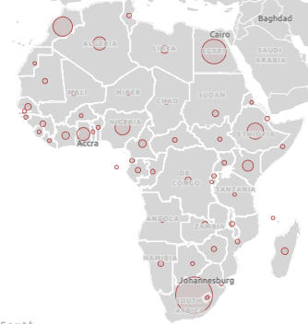
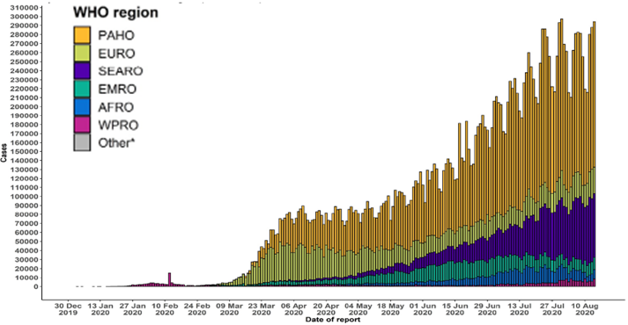
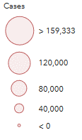
COVID-19 epidemic in Africa
In Africa, 1 Jan – 9 Sept, there were:
1,091,012 cumulative cases
23,323 deaths

Slide 9
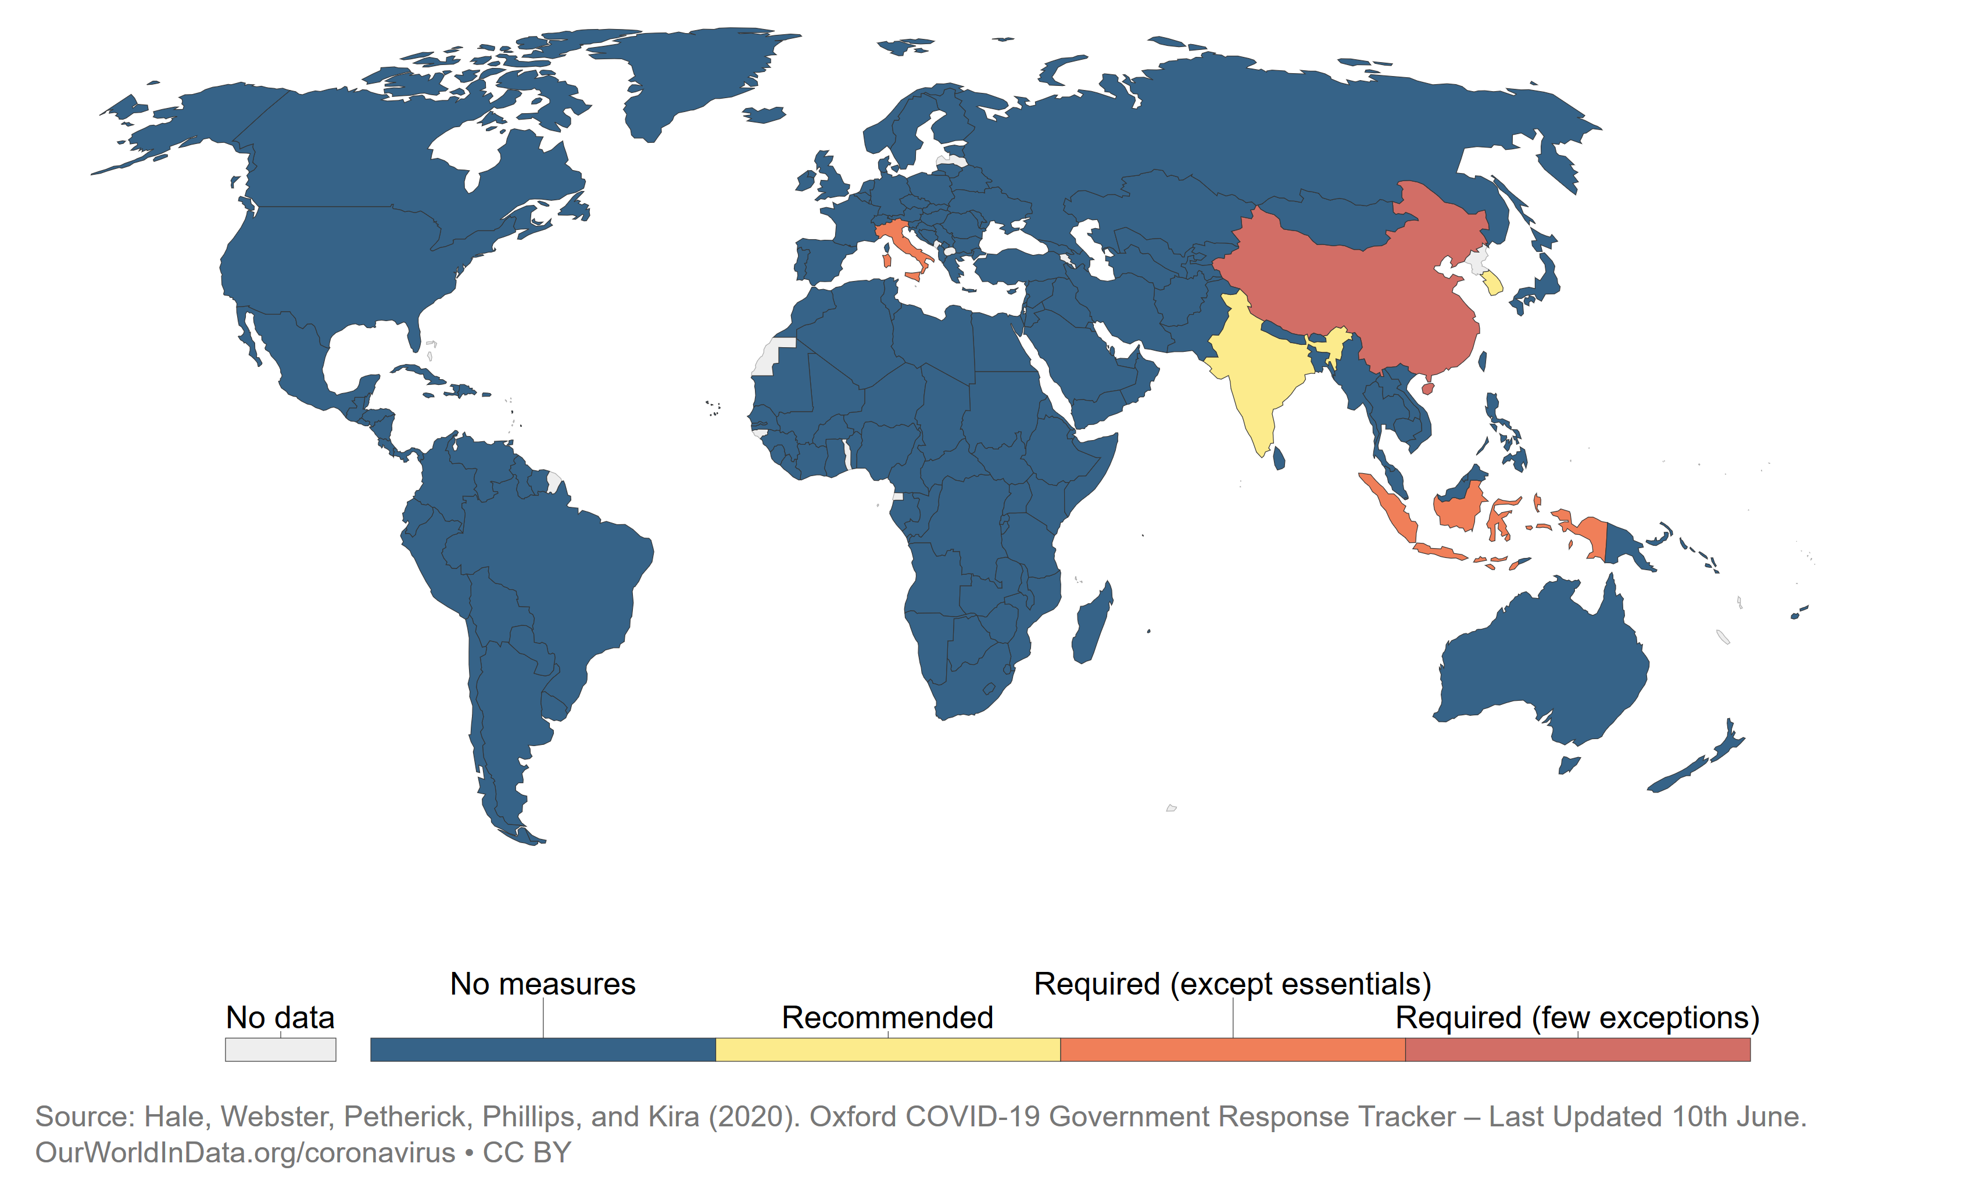
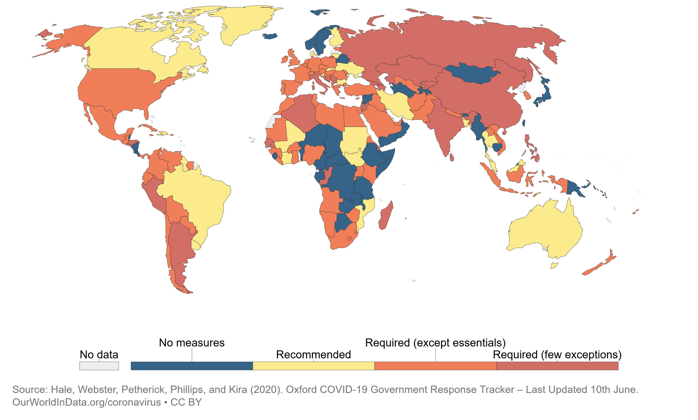
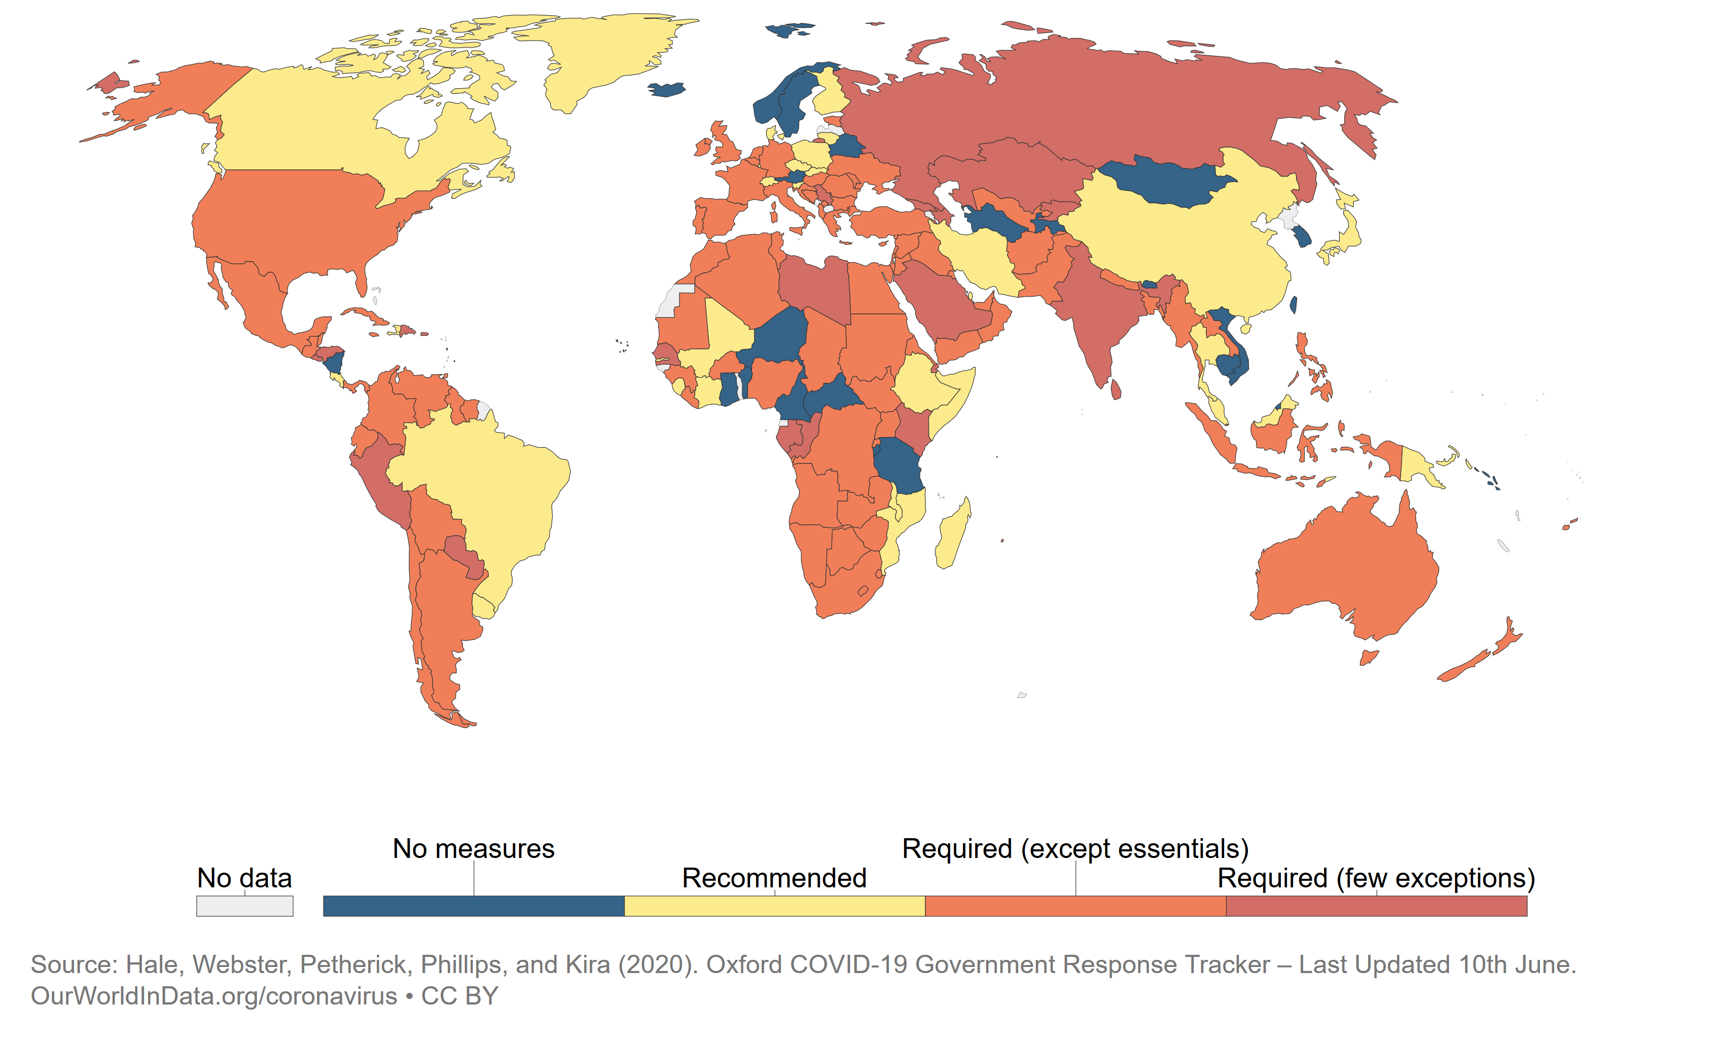
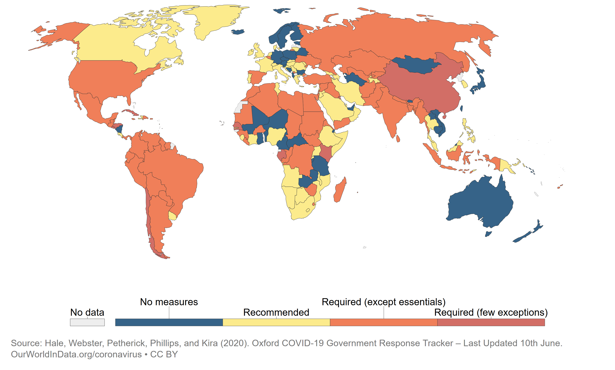
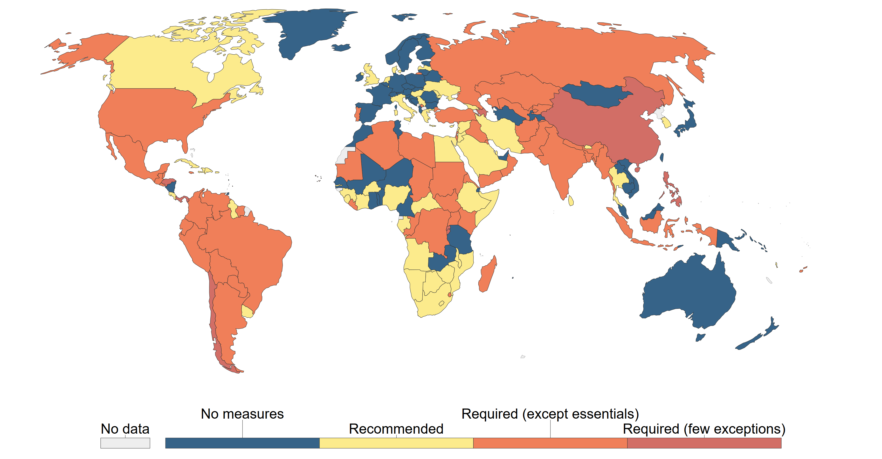
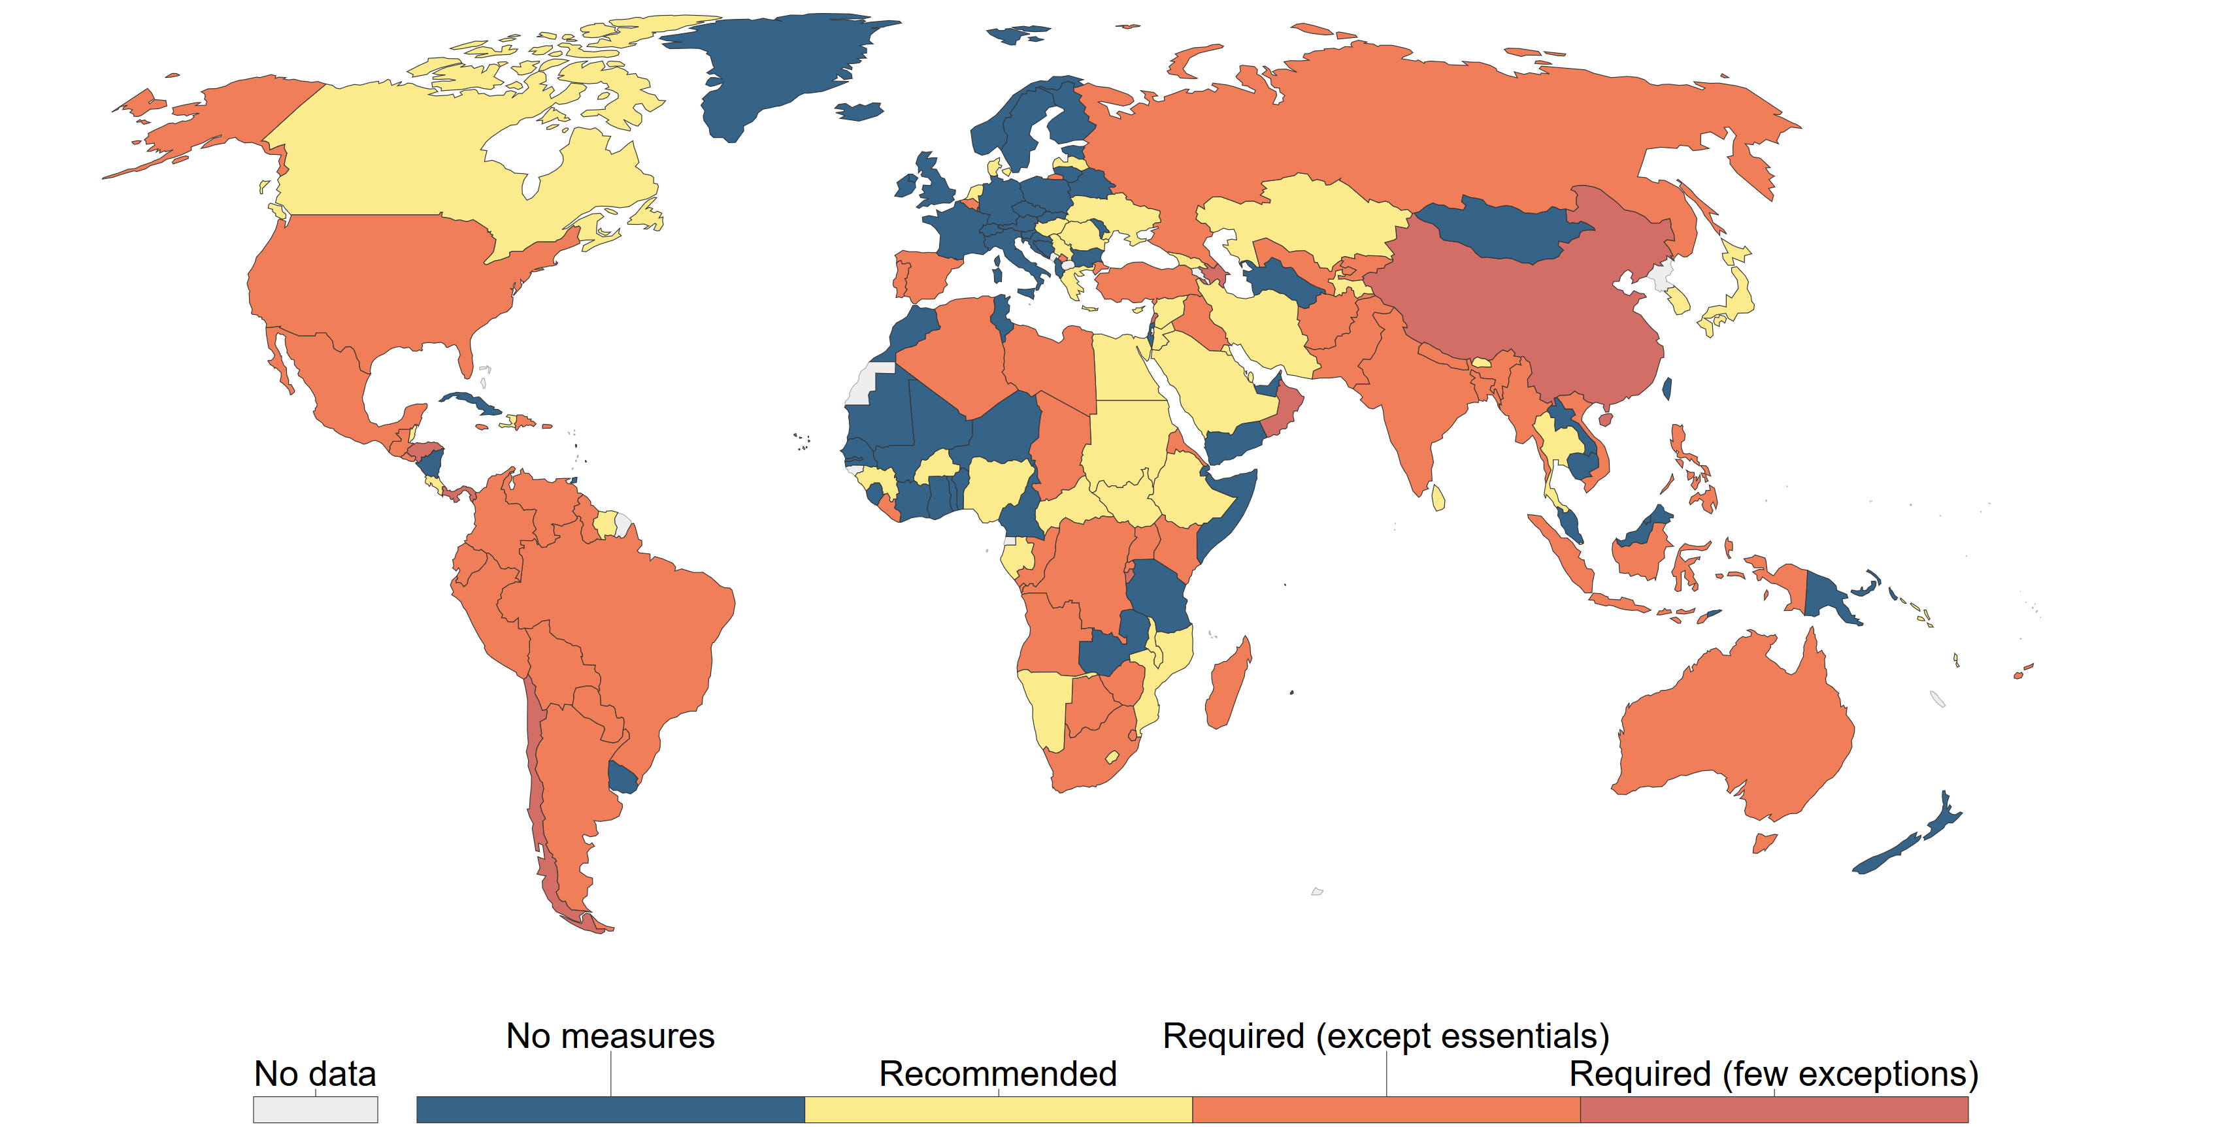
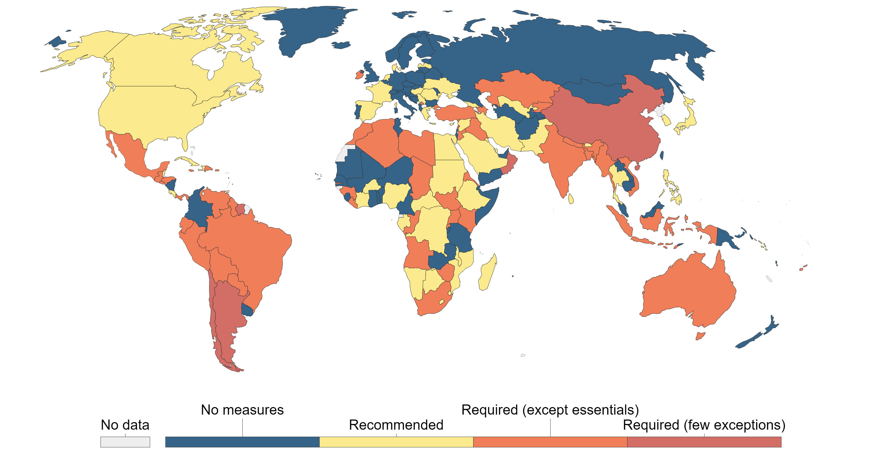
Stay-at-home restrictions during the Covid-19 pandemic
1 April:
86 countries on national or sub national lockdown
1 June
1 July
1 March
1 August
1 May
1 September

Slide 10


Burden of Covid-19 in South Africa
7-day moving average of new cases, sentinel hospital admissions and Covid-19 deaths – to 8 Sept
New cases
Source: Lucille Blumberg and Waasila Jassat – DATCOV, NICD
*proportion of the population that have confirmed Covid-19 - cumulative risk (%)

Slide 11
Outline
Learning from the past….
….. to better prepare interventions for future pandemics
Drawing on epidemic experiences in Africa
  Ebola
  HIV
  Covid-19
Key lessons on interventions for future pandemics
Intervention choices
Planning for a marathon, not a sprint
Conclusion - Five key lessons from epidemics in Africa

Slide 12

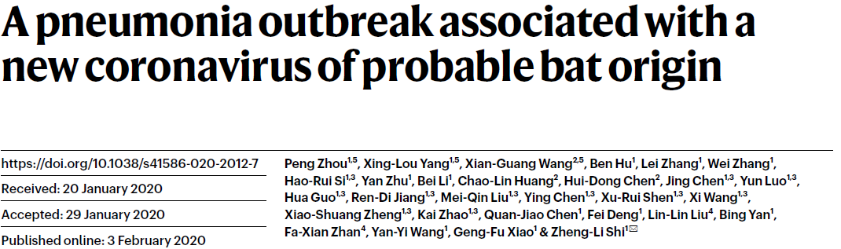
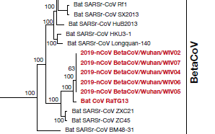
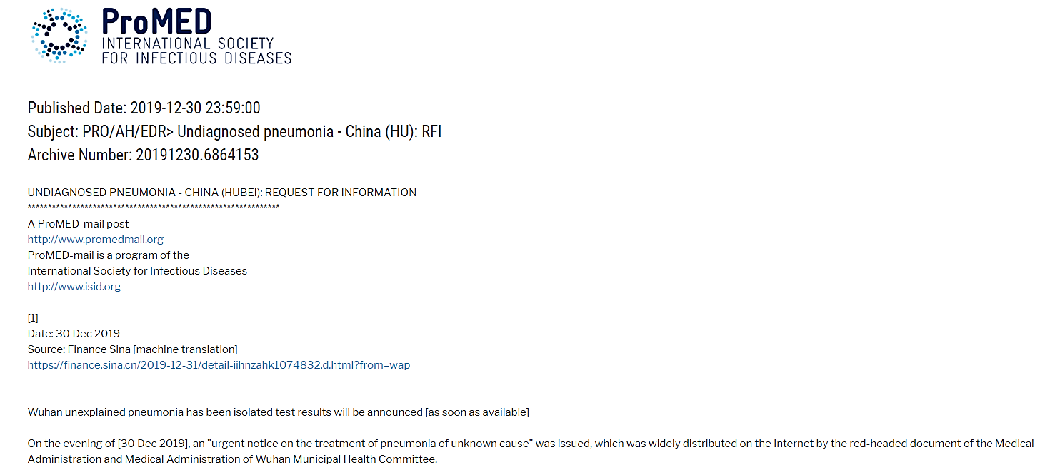
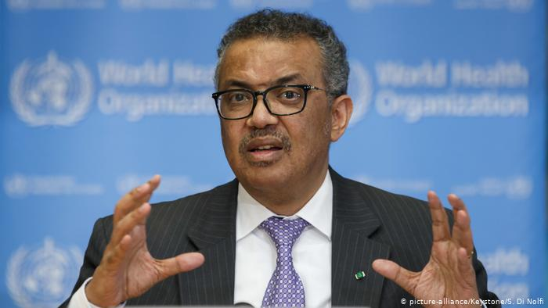

Covid-19 – key lessons for future pandemics:
1a. Early identification and action at global level
30 Dec 2019
First genetic sequence of SARS-CoV-2 – 10 January
Covid-19 a global health emergency - 30 January
…”We have therefore made the assessment that COVID-19 can be characterized as a pandemic.”…. - 11 March 2020

Slide 13
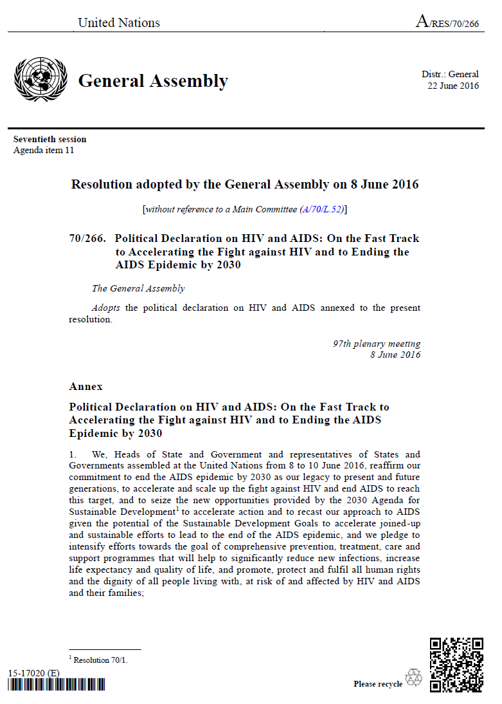
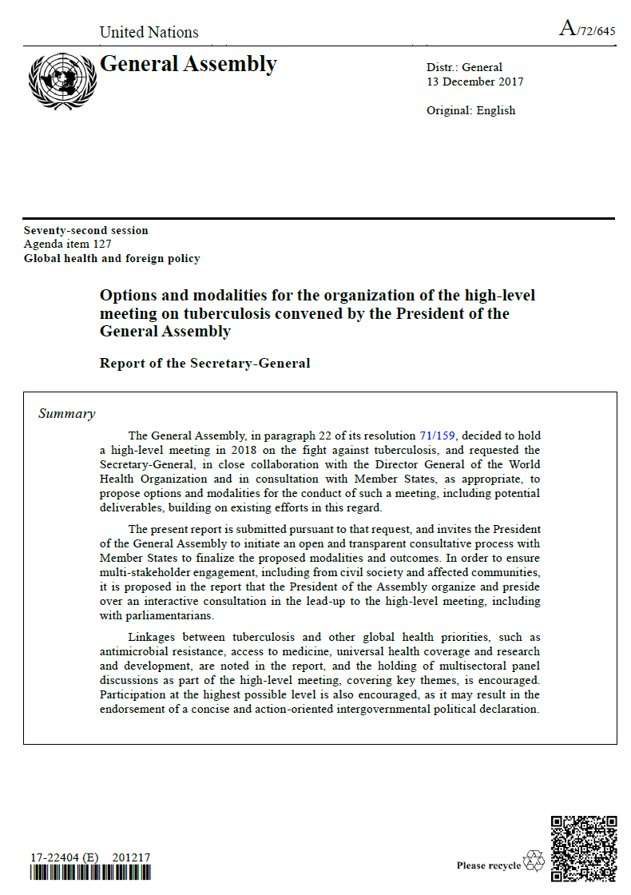
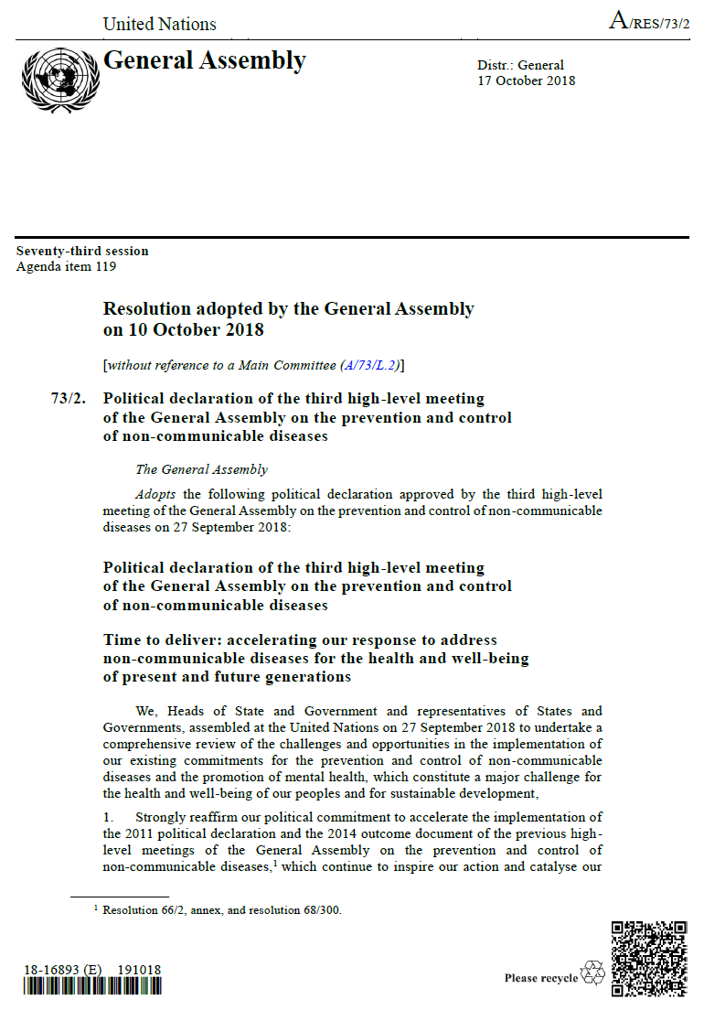
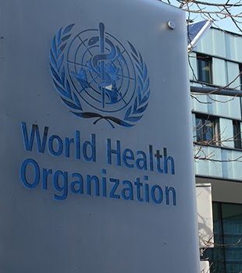
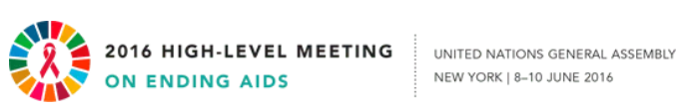

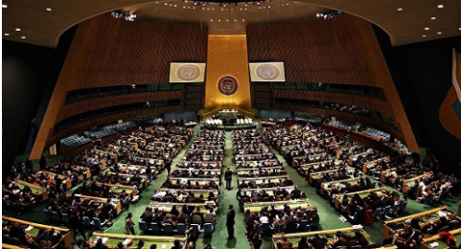
Covid-19 – key lessons for future pandemics:
1b. Global leadership and governance
United Nations has had high-level meetings:
  ✓ HIV
  ✓ Tuberculosis
  Non-communicable
  diseases
  ? Covid-19

Slide 14
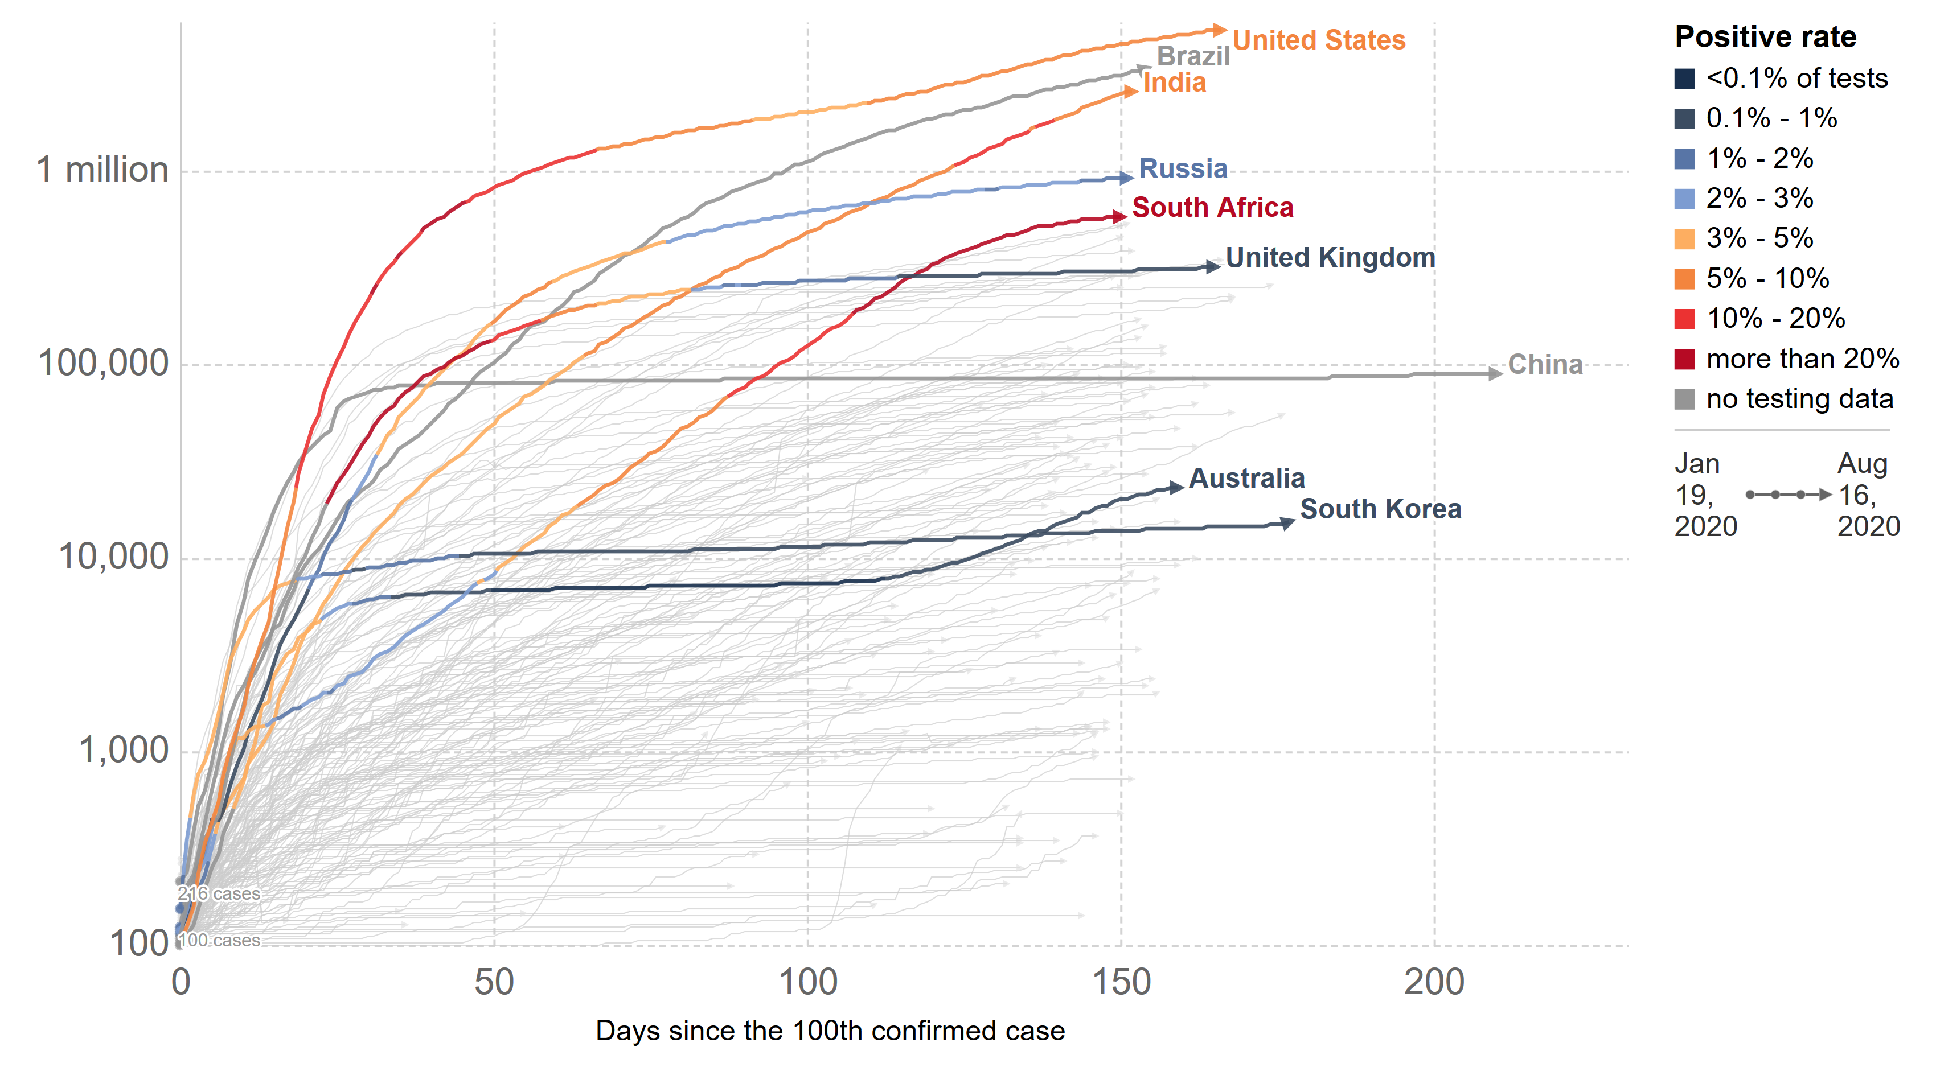
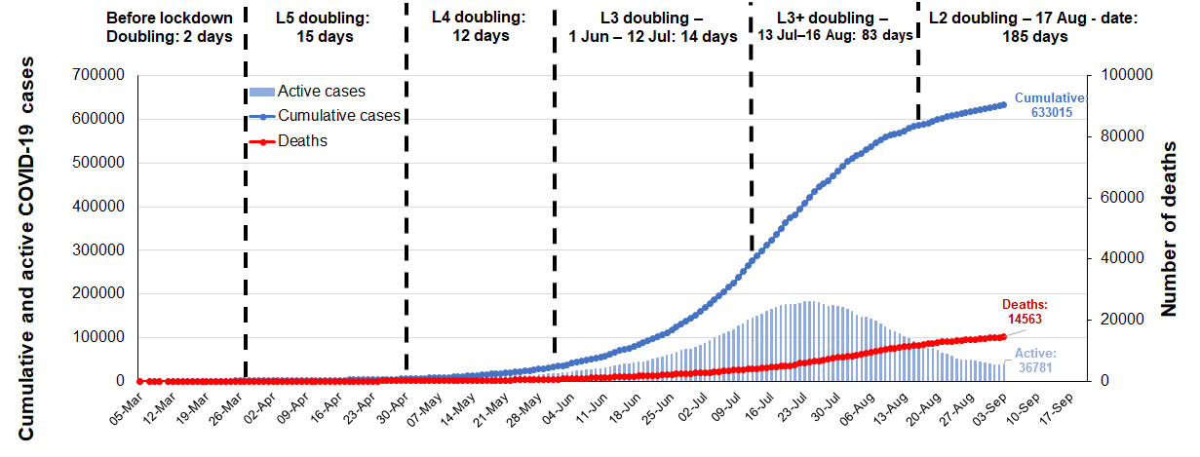
Covid-19 – key lessons for future pandemics:
1c. Early identification and action at country level to contain / mitigate spread of virus

Slide 15



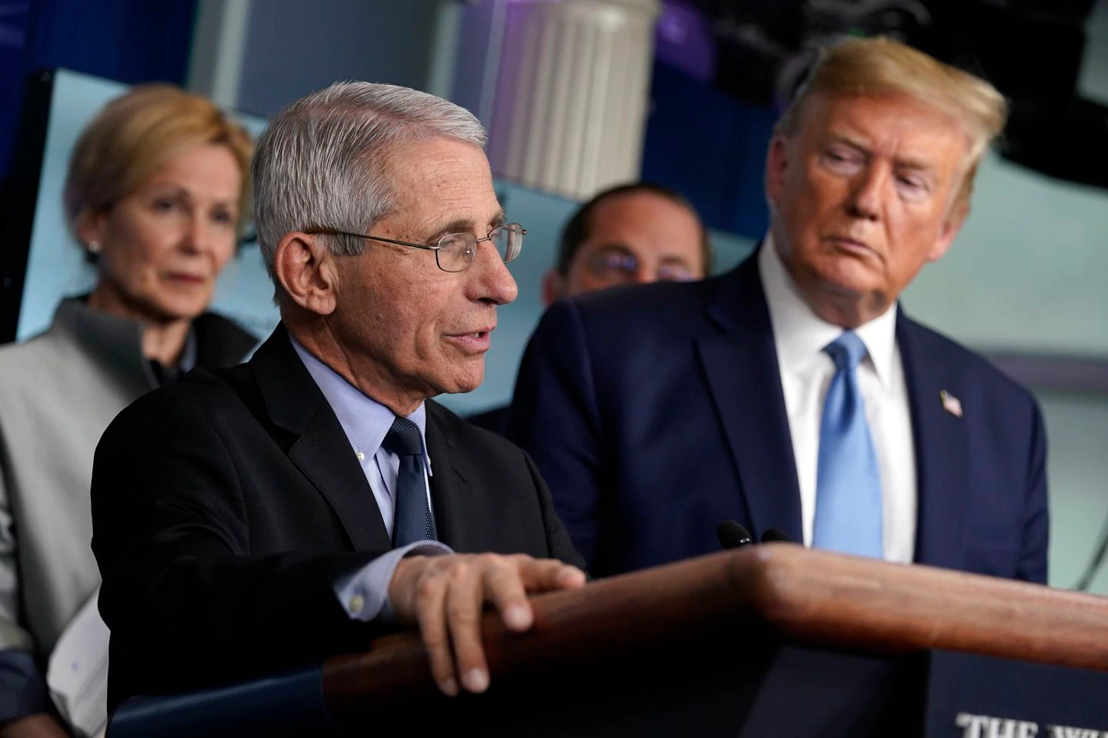
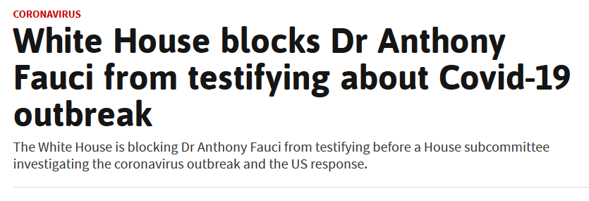
Covid-19 – key lessons for future pandemics:
2. Avoid denial, interference and division by politicians
“We’re prepared, and we’re doing a great job with it. And it will go away. Just stay calm. It will go away.”
— Meeting with Republican senators, March 10

Slide 16
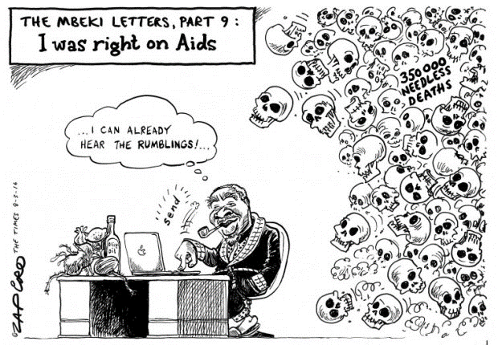
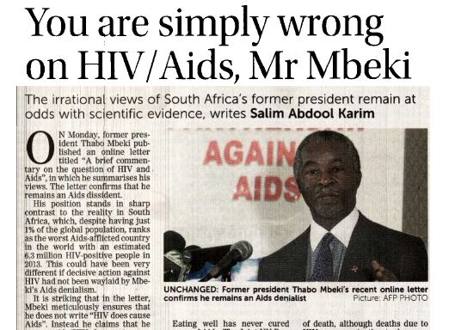
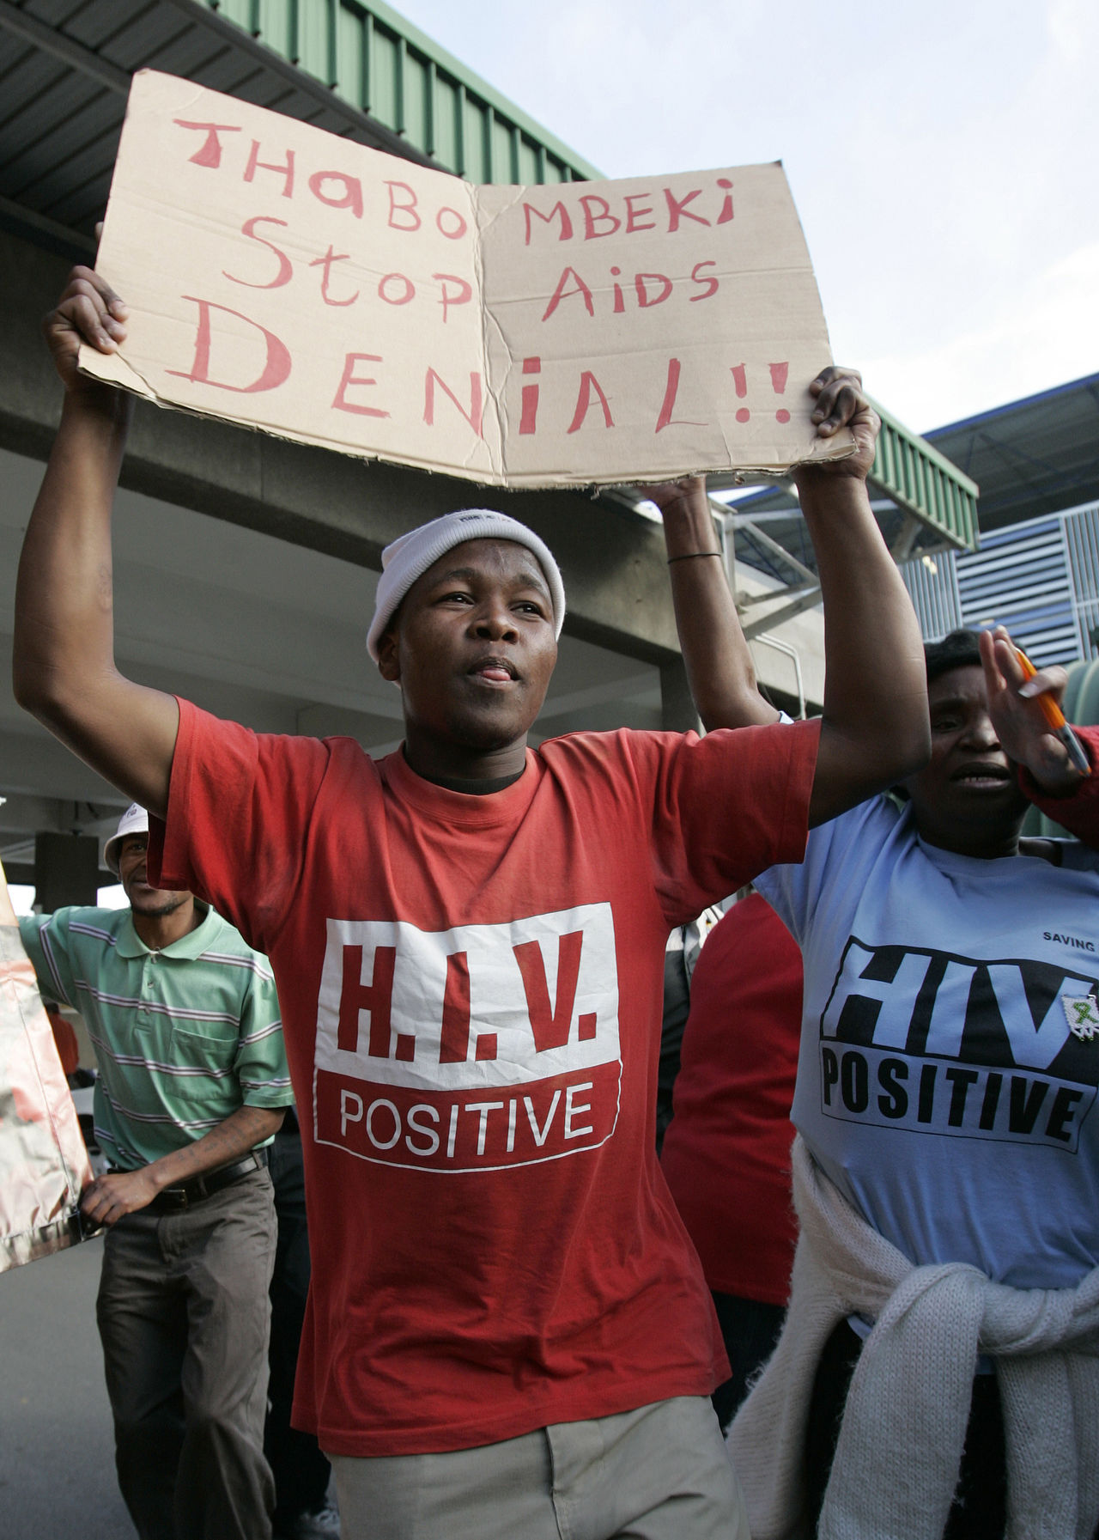
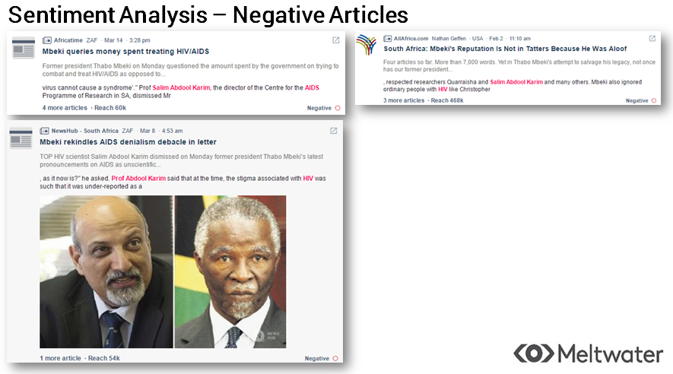
Denialism compromised South Africa’s HIV response – this affliction has impacted the
Covid-19 response of some other countries

Slide 17


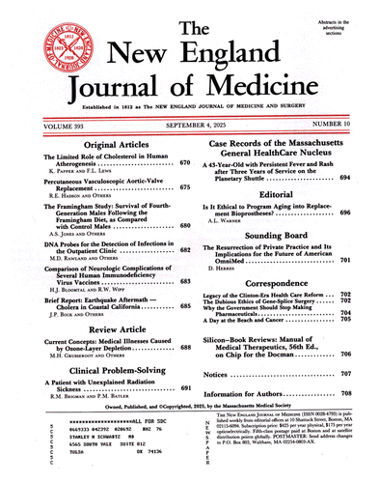
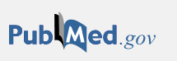


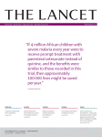

Covid-19 – key lessons for future pandemics:
3. Importance of science and rapid freely available information
Explosion of knowledge – scientific papers since Jan 2020:
52,605 articles
8,547 Articles

Slide 18
Outline
Learning from the past….
….. to better prepare interventions for future pandemics
Drawing on epidemic experiences in Africa
  Ebola
  HIV
  Covid-19
Key lessons on interventions for future pandemics
Intervention choices
Planning for a marathon, not a sprint
Conclusion - Five key lessons from epidemics in Africa

Slide 19
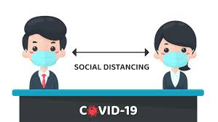
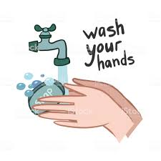
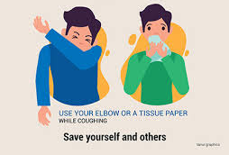







Intervention choices: Covid-19 prevention toolbox
Hand hygiene practices - hand washing / sanitizing
Social
distancing
Cloth masks & cough etiquette
Testing,
isolation, quarantine & contact tracing
Frequent
environmental cleaning & fresh air ventilation
Appropriate
use of PPE
Symptom screening
Lockdown (extreme form of social distancing)

Slide 20











Intervention choices: HIV prevention toolbox
Male circumcision
Auvert B, PloS Med 2005
Gray R, Lancet 2007
Bailey R, Lancet 2007
Treatment of STIs
Microbicides
for women
Grosskurth H, Lancet 2000
Abdool Karim Q, Science 2010
Female Condoms
Oral pre-exposure prophylaxis
HIV
prevention
toolbox
Grant R, NEJM 2010 (MSM)
Baeten J , NEJM 2012 (Couples)
Thigpen M, NEJM 2012 (Heterosexuals)
Choopanya K, Lancet 2013 (IDU)
Male Condoms
HIV Counselling and Testing
Dapivirine intravaginal ring
Coates T, Lancet 2000
Sweat M, Lancet 2011
Baeten J, NEJM 2016
Post Exposure
prophylaxis (PEP)
Treatment for prevention
Behavioural Intervention
Cohen M, NEJM, 2011
Donnell D, Lancet 2010
Tanser, Science 2013
Abstinence
Be Faithful
Scheckter M, 2002
Note: PMTCT, Screening transfusions, Harm reduction, Universal precautions, etc. have not been included – this is on sexual transmission

Slide 21
The evolving Covid-19 response
Planning for a marathon – not a sprint
Virus spreading - trying to flatten the curve
Lifting some restrictions with mitigation measures
Very low / sporadic transmission
Sustained resumption of all activities
Epidemic
Containment / low transmission
Co-existing with the virus
Vaccine / Cure Threat low
a
a
Risk of reversion to epidemic state
Planning - To live with Coronavirus threat until ~2021
Transitioning from “Anxiety to Self-efficacy” - empowering people for sustainable self-implementation of prevention
Enabling the new normal while mitigating risk of resurgence

Slide 22



Covid-19: Pivoting the prevention paradigm
Initial - government action
Pivot –
prevention approach
Subsequent - Individual
action
To reach –
collective
community action
Anxiety
Agency
Self-efficacy
Collectivism
Institutional
power
over people
Individuals power within people
Motivated individuals
power to act for prevention
Motivated communities
power for collective action
Ubuntu
“I am, because you are”
Stay-at-home orders / Lockdown
Public health
interventions

Slide 23
5 key lessons from past epidemics in Africa – for interventions in future pandemics
Global interdependence – global / regional / country leadership
Community involvement – valuing collectivism (Ubuntu) – I am safe, when you are safe
Working together for early identification (surveillance)
Evidence-based policy and decision making - Comprehensive approach to epidemic control and not banking on a silver bullet
Global solidarity (e.g., COVAX challenging vaccine nationalism)

