Slide 1
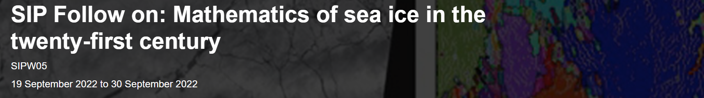


Coupled free vibration of liquid in tanks with membrane/ice covers
Dr. Kang Ren (k.ren@ucl.ac.uk)
Department of Mechanical Engineering, Faculty of Engineering Sciences, UCL
28th September 2022, Isaac Newton Institute for Mathematical Sciences

Slide 2
Outlines
Background and motivations
Assumptions of the mathematical modelling
Technical challenges
Coupled free vibration analysis in
Conclusions
Cylindrical tank with elastic cover
Cubic tank with elastic cover

Slide 3
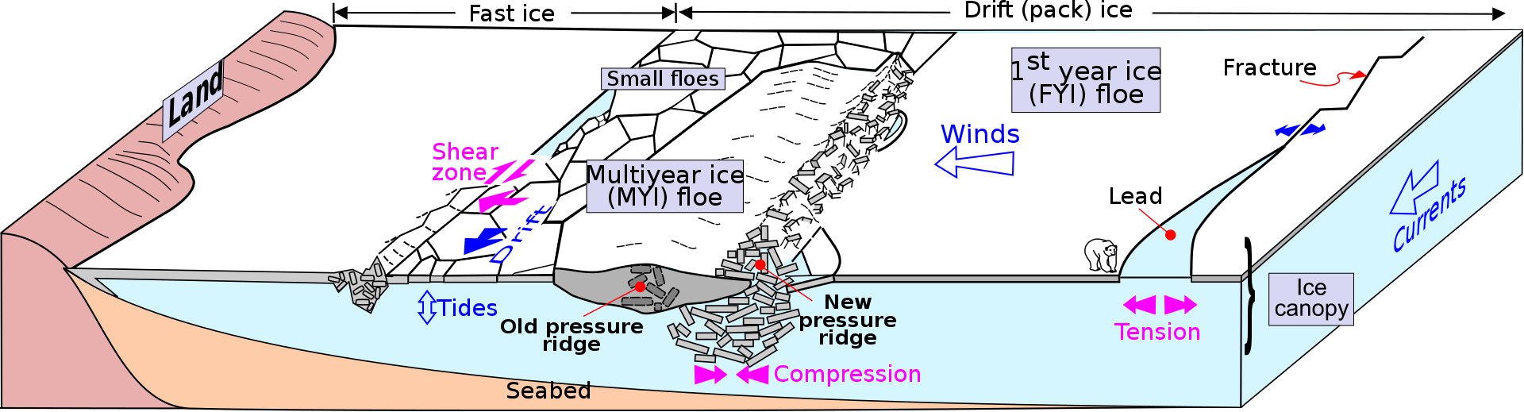
Background and Motivations
Ice-covered ocean
Ice-covered channel/river
Environmental features of sea ice
(file source: https://commons.wikimedia.org/wiki/File:Sea_ice_Drawing_General_features.svg)
- C. Fox, and V.A. Squire. "On the oblique reflexion and transmission of ocean waves at shore fast sea ice." Phil. Trans. R. Soc. A. 347, no. 1682 (1994): 185-218.
- V.A. Squire, "Of ocean waves and sea-ice revisited." Cold Reg Sci Technol 49, no. 2 (2007): 110-133.
- A.A. Korobkin, T.I. Khabakhpasheva, and A.A. Papin. "Waves propagating along a channel with ice cover.“ Eur. J. Mech. B Fluids 47 (2014): 166-175.
- K. Ren, G.X. Wu, and Z.F. Li. "Hydroelastic waves propagating in an ice-covered channel.“ J. Fluid Mech. 886 (2020).

Slide 4
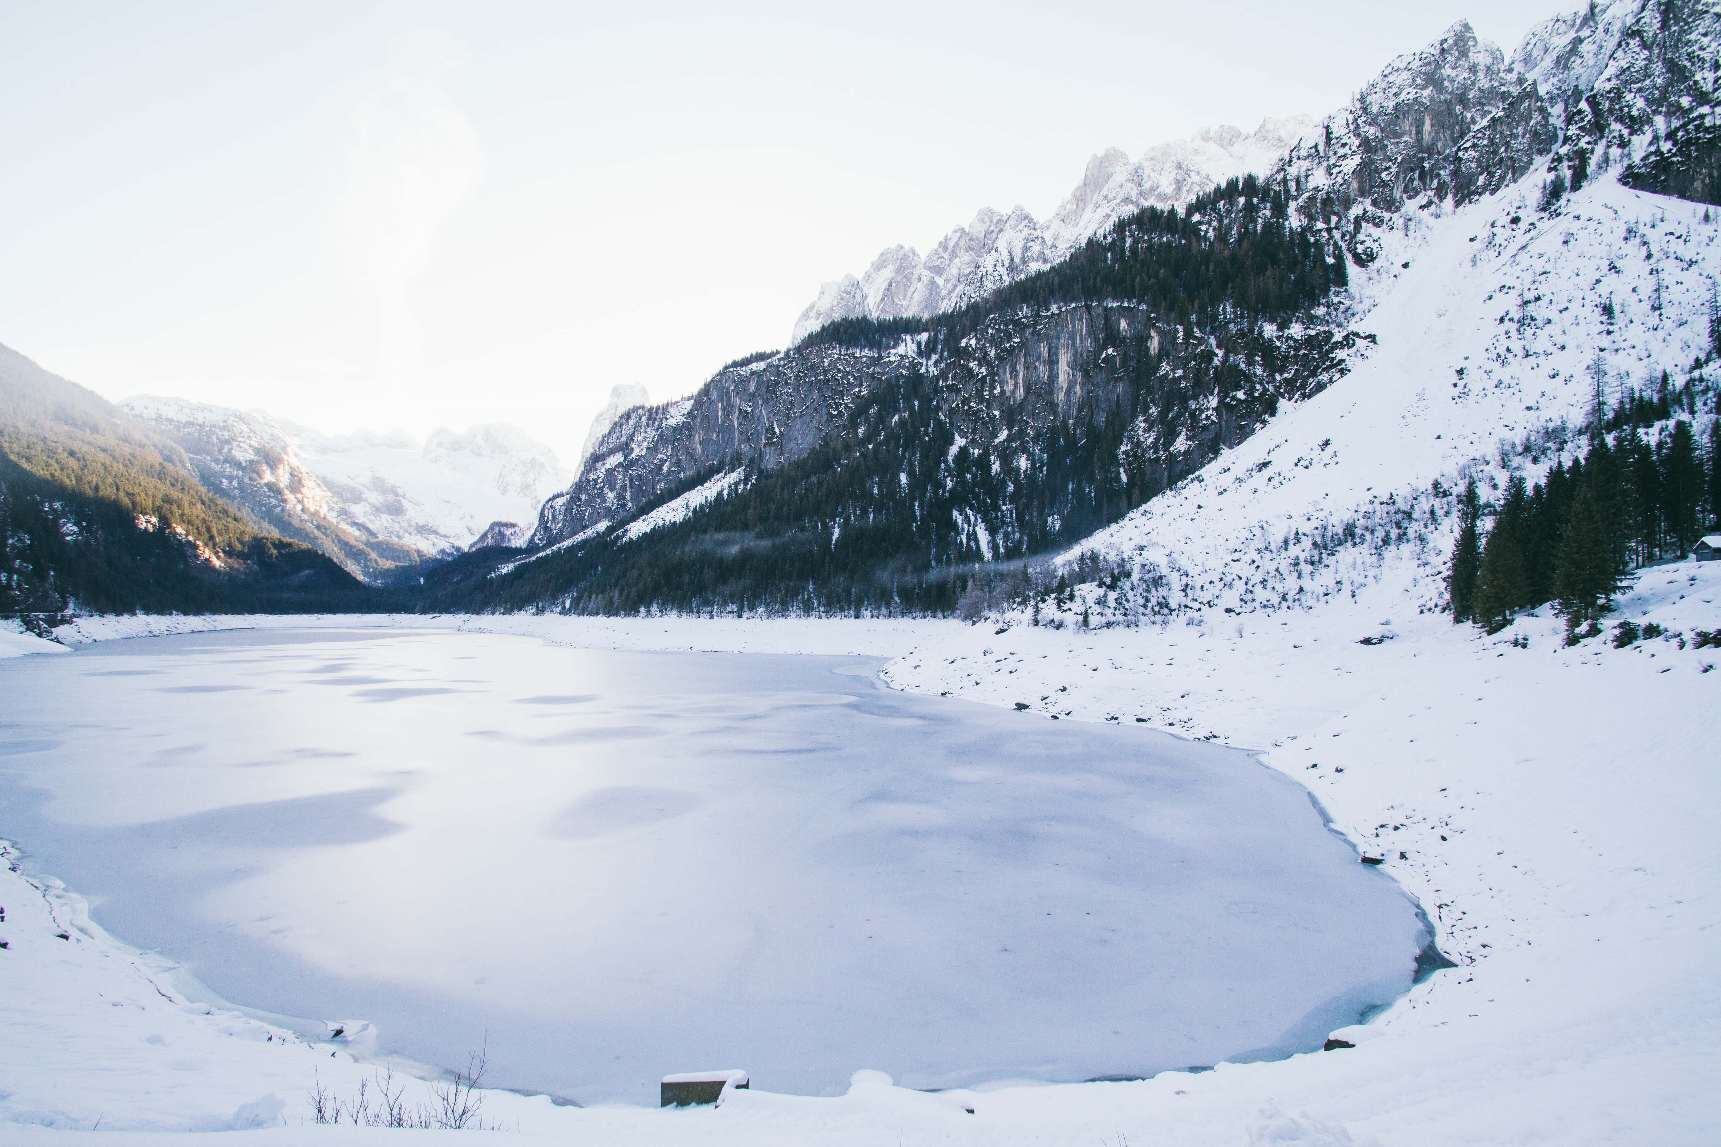
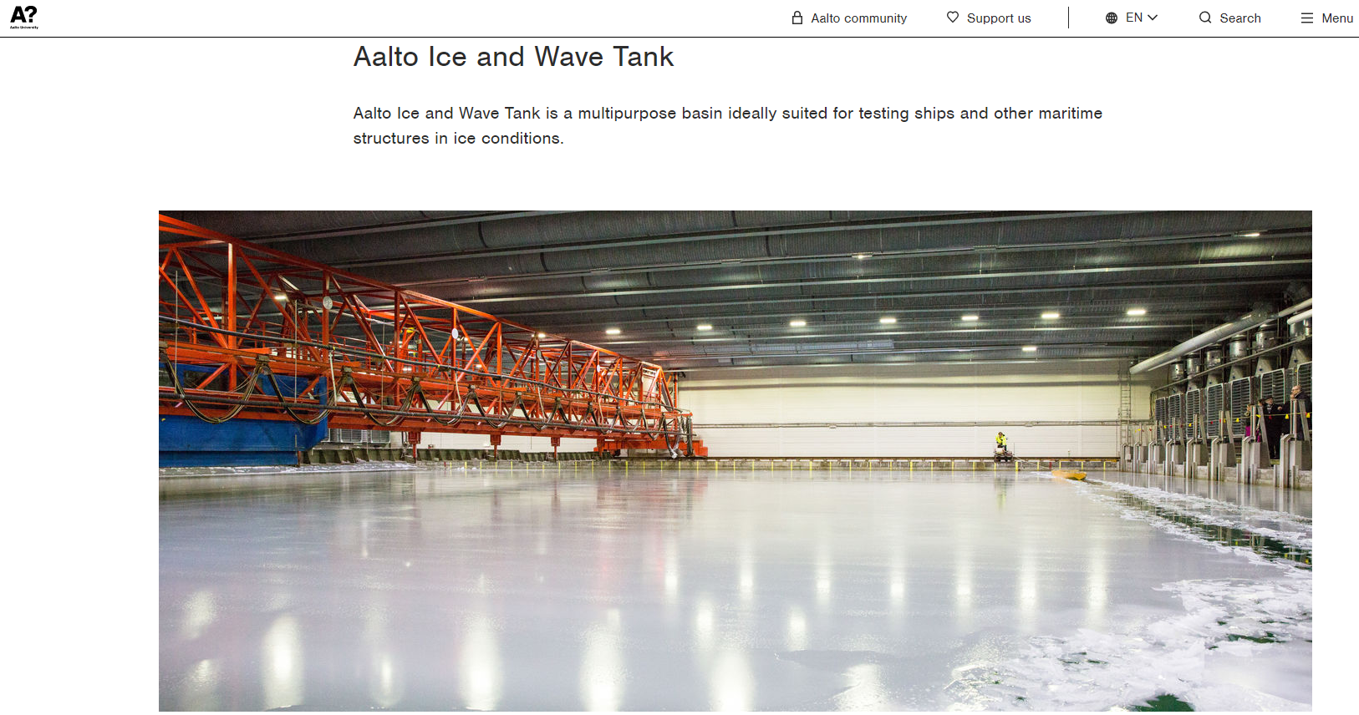

Background and Motivations
Frozen ponds, lakes and reservoirs
Ice tanks in laboratory
Frozen lake surrounded with snow
(@Liezen, Steiermark, Austria)
Aalto ice/wave tank ($40m×40m×2.8m$)
(https://www.aalto.fi/en/research-and-learning-infrastructures/aalto-ice-and-wave-tank)

Slide 5
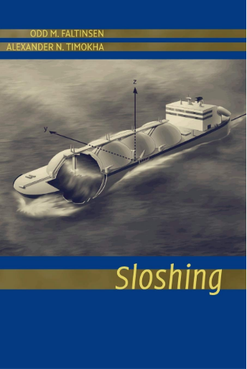
Background and Motivations
Sloshing dynamics in tanks has a wide range of applications:
LNG storage & transportation
TLD in high-rise buildings
“Seiche” in lakes, reservoirs, bays, harbors…
Anti-rolling tanks in ships & offshore structures
LH2 in propellant container of spacecraft
Wave tanks
- O. M. Faltinsen and A. N. Timokha, Sloshing (Cambridge University Press, Cambridge, 2009).

Slide 6
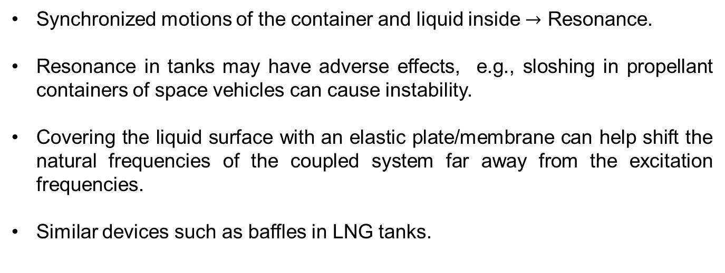
Background and Motivations
Coupled fluid-structure vibration in tanks
Synchronized motions of the container and liquid inside $→$ Resonance.
Resonance in tanks may have adverse effects, e.g., sloshing in propellant containers of space vehicles can cause instability.
Covering the liquid surface with an elastic plate/membrane can help shift the natural frequencies of the coupled system far away from the excitation frequencies.
Similar devices such as baffles in LNG tanks.

Slide 7
Assumptions for the mathematical modelling
Velocity potential theory for the flow
Small amplitude motion (linearization)
Linear elastic theory for the cover
No gap between elastic cover and fluid
Rigid surface for tank bottom and walls

Slide 8

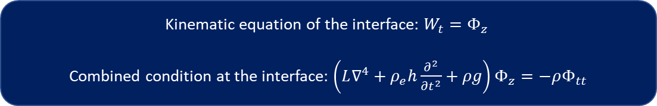

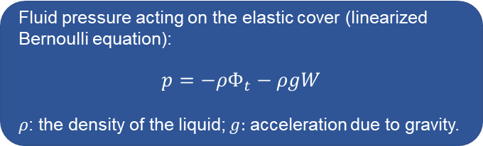
Technical Challenges
Treatment of the high-order derivatives in elastic cover conditions
$$.$$
Governing equation for the cover (dynamic equation):
$$ρ_{e}h W_{tt}+L∇^{4}W=p, \left(for plate\right)$$
$$ρ_{e}h W_{tt}+T∇^{2}W=p. \left(for membrane\right)$$
$W$: deflection of the elastic cover; $L$: flexural rigidity; $T:$ tension.
Fluid pressure acting on the elastic cover (linearized Bernoulli equation):
$$p=−ρΦ_{t}−ρgW$$
$ρ$: the density of the liquid; $g:$ acceleration due to gravity.
Kinematic equation of the interface: $W_{t}=Φ_{z}$
Combined condition at the interface: $\left(L∇^{4}+ρ_{e}h\frac{∂^{2}}{∂t^{2}}+ρg\right)Φ_{z}=−ρΦ_{tt}$
- H.F. Bauer, “Coupled frequencies of a liquid in a circular cylindrical container with elastic liquid surface cover,” J. Sound Vib. 180, 689–704 (1995).

Slide 9




Technical Challenges
Enforcement of various edge conditions
Three common conditions for a curved-shape edge can be written as (Timoshenko and Woinowsky-Krieger, 1959)
$n$ and $s$ are the normal and circumferential unit vectors of the edge; $ν$: the Poisson's ratio; $ℛ$: the radius of curvature.
Clamped edge:
W$=0,$
$$W_{n}=0;$$
Free edge:
(e.g., Eqs. (A1) and (A2) in Ren et al., JFS, 2018)
$$\begin{aligned}∇^{2}W=\left(1−ν\right)\left[\frac{∂^{2}}{∂s^{2}}+\frac{1}{ℛ}\frac{∂}{∂n}\right]W, \\ \\ \frac{∂}{∂n}\left[∇^{2}W\right]=−\left(1−ν\right)\frac{∂}{∂s}\left[\frac{∂^{2}}{∂s∂n}−\frac{1}{ℛ}\frac{∂}{∂s}\right]W\end{aligned}$$
Simply supported edge:
W$=0,$
$$∇^{2}W=\left(1−ν\right)\left[\frac{∂^{2}}{∂s^{2}}+\frac{1}{ℛ}\frac{∂}{∂n}\right]W$$
- S.P. Timoshenko and S. Woinowsky-Krieger, Theory of Plates and Shells (McGraw-Hill, New York, 1959).
- K. Ren, G.X. Wu, and C.Y. Ji. "Wave diffraction and radiation by a vertical circular cylinder standing in a three-dimensional polynya." J. Fluids Struct. 82, 287-307. (2018).

Slide 10
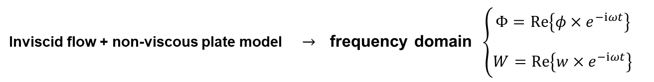
Coupled free vibration analysis in a tank with elastic cover
Free vibration: the liquid is set into motion by some initial disturbance and will continue oscillating on its own without further excitation.
With damping:
the oscillation will decay with time and finally stop.
Without damping:
the oscillation will always exist at its natural modes.
Inviscid flow + non-viscous plate model $→$ frequency domain $\left\{\begin{aligned}Φ=Re\left\{φ×e^{−iωt}\right\} \\ \\ W=Re\left\{w×e^{−iωt}\right\}\end{aligned}\right.$

Slide 11
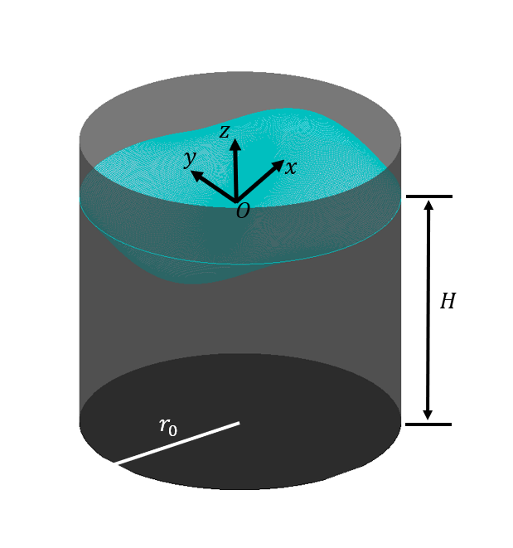
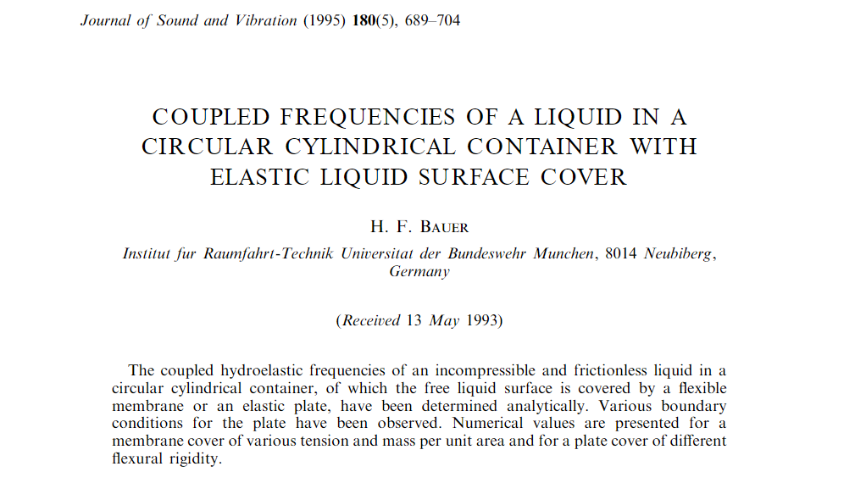
Circular cylindrical tank case
H.F. Bauer, “Coupled frequencies of a liquid in a circular cylindrical container with elastic liquid surface cover,” J. Sound Vib. 180, 689–704 (1995).
K. Ren, G.X. Wu, and Z.F. Li. "Natural modes of liquid sloshing in a cylindrical container with an elastic cover." J. Sound Vib. 512, 116390 (2021).

Slide 12
Circular cylindrical tank case
Bessel-Fourier expansions:
 | Bauer (1995, JSV) | Ren et.al. (2021, JSV)
Velocity potential: | Bessel-Fourier expansions in the horizontal directions: double series
Cover deflection: | One double series + One single series: the latter differs from that in velocity potential. | Same type of expansions as the velocity potential.
Matching conditions on the interface: | Each element in the single series should be expanded into Bessel series first, the unknowns are coupled. | Orthogonality can be used to get a one-to-one relationship of coefficients in velocity potential and cover deflection.
Size of the coefficient matrix: | Infinite. | Only 2-by-2.
Natural frequencies: | Determinant of truncated coefficient matrix = 0 | Explicit equations can be easily obtained

Slide 13
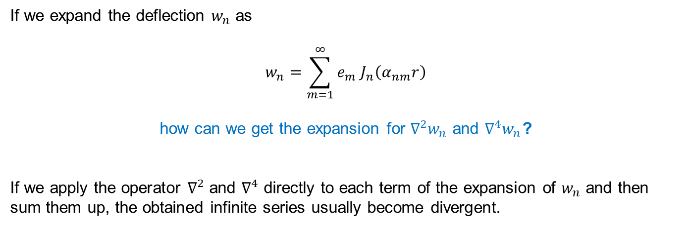
Circular cylindrical tank case
Bessel-Fourier expansions: dealing with the high-order derivatives
If we expand the deflection $w_{n}$ as
$$w_{n}=\sum_{m=1}^{∞}{e_{m} J_{n}\left(α_{nm}r\right)}$$
how can we get the expansion for $∇^{2}w_{n}$ and $∇^{4}w_{n}$?
If we apply the operator $∇^{2}$ and $∇^{4}$ directly to each term of the expansion of $w_{n}$ and then sum them up, the obtained infinite series usually become divergent.
We may find some clues by comparing Bessel series with the Fourier series.
Fourier series is not always differentiable but integratable.

Slide 14
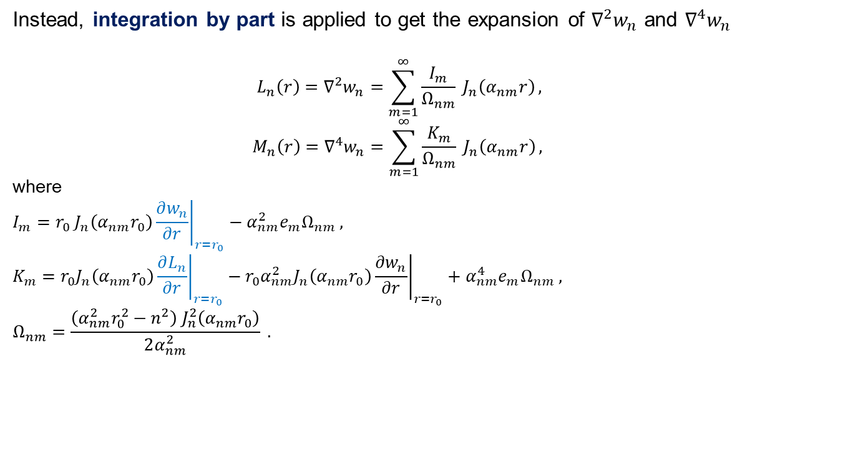
Circular cylindrical tank case
Bessel-Fourier expansions: dealing with the high-order derivatives
Instead, integration by part is applied to get the expansion of $∇^{2}w_{n}$ and $∇^{4}w_{n}$
$$L_{n}\left(r\right)=∇^{2}w_{n}=\sum_{m=1}^{∞}{\frac{I_{m}}{Ω_{nm}} J_{n}\left(α_{nm}r\right)},$$
$$M_{n}\left(r\right)=∇^{4}w_{n}=\sum_{m=1}^{∞}{\frac{K_{m}}{Ω_{nm}} J_{n}\left(α_{nm}r\right)},$$
where
$$I_{m}=r_{0} J_{n}\left(α_{nm}r_{0}\right){\left.\frac{∂w_{n}}{∂r}\right|}_{r=r_{0}}−α_{nm}^{2}e_{m}Ω_{nm} ,$$
$$K_{m}=r_{0}J_{n}\left(α_{nm}r_{0}\right){\left.\frac{∂L_{n}}{∂r}\right|}_{r=r_{0}}−r_{0}α_{nm}^{2}J_{n}\left(α_{nm}r_{0}\right){\left.\frac{∂w_{n}}{∂r}\right|}_{r=r_{0}}+α_{nm}^{4}e_{m}Ω_{nm} ,$$
$$Ω_{nm}=\frac{\left(α_{nm}^{2}r_{0}^{2}−n^{2}\right) J_{n}^{2}\left(α_{nm}r_{0}\right)}{2α_{nm}^{2}} .$$

Slide 15
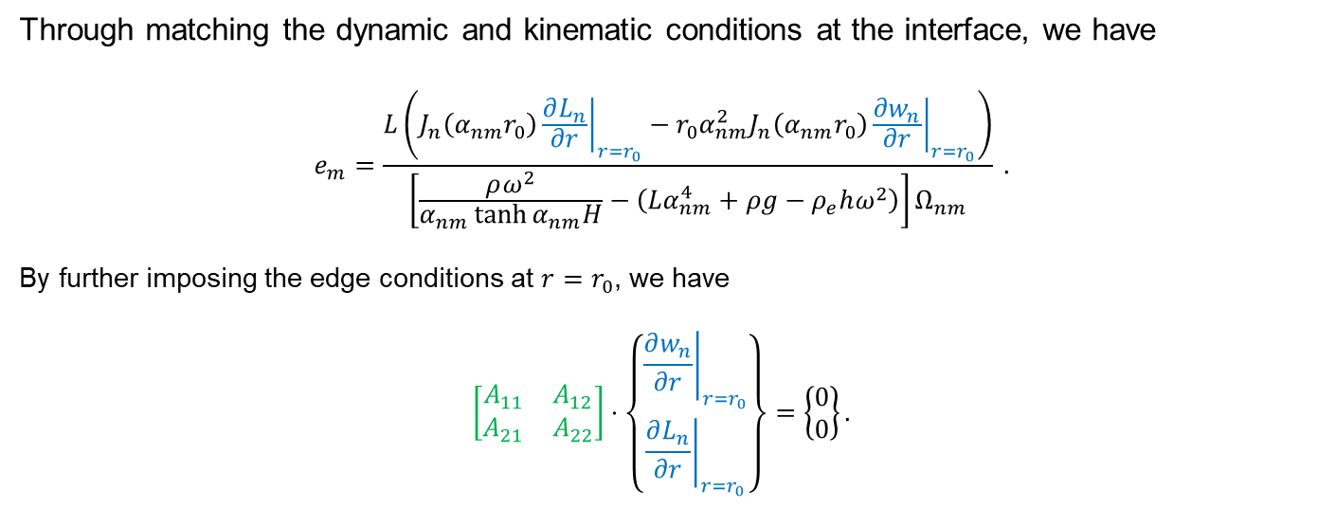
Circular cylindrical tank case
Bessel-Fourier expansions: dealing with the high-order derivatives
Through matching the dynamic and kinematic conditions at the interface, we have
$$e_{m}=\frac{L\left(J_{n}\left(α_{nm}r_{0}\right){\left.\frac{∂L_{n}}{∂r}\right|}_{r=r_{0}}−r_{0}α_{nm}^{2}J_{n}\left(α_{nm}r_{0}\right){\left.\frac{∂w_{n}}{∂r}\right|}_{r=r_{0}}\right)}{\left[\frac{ρω^{2}}{α_{nm}\tanh{α_{nm}H}}−\left(Lα_{nm}^{4}+ρg−ρ_{e}hω^{2}\right)\right]Ω_{nm}} .$$
By further imposing the edge conditions at $r=r_{0}$, we have
$$\left[\begin{matrix}A_{11} & A_{12} \\ A_{21} & A_{22}\end{matrix}\right]⋅\left\{\begin{aligned}{\left.\frac{∂w_{n}}{∂r}\right|}_{r=r_{0}} \\ {\left.\frac{∂L_{n}}{∂r}\right|}_{r=r_{0}}\end{aligned}\right\}=\left\{\begin{aligned}0 \\ 0\end{aligned}\right\}.$$

Slide 16
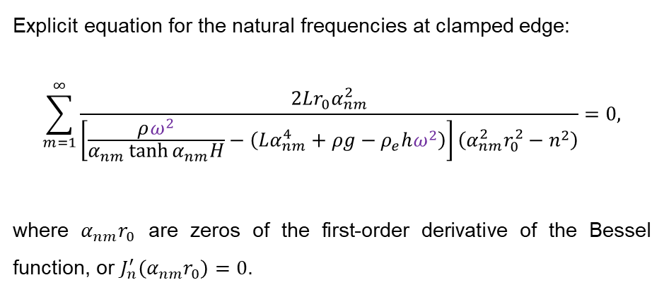
Circular cylindrical tank case
Bessel-Fourier expansions:
Explicit equation for the natural frequencies at clamped edge:
$$\sum_{m=1}^{∞}{\frac{2Lr_{0}α_{nm}^{2}}{\left[\frac{ρω^{2}}{α_{nm}\tanh{α_{nm}H}}−\left(Lα_{nm}^{4}+ρg−ρ_{e}hω^{2}\right)\right]\left(α_{nm}^{2}r_{0}^{2}−n^{2}\right)}}=0,$$
where $α_{nm}r_{0}$ are zeros of the first-order derivative of the Bessel function, or $J_{n}^{′}\left(α_{nm}r_{0}\right)=0$.
Note: when $ρ=0$, the explicit equations will be reduced to those of a circular plate in the vacuum, which can be further proved to be equivalent to the equations provided in Wah (1962) without tension.
- T. Wah, Vibration of circular plates, J. Acoust. Soc. Am., 34, 275-281, (1962)

Slide 17
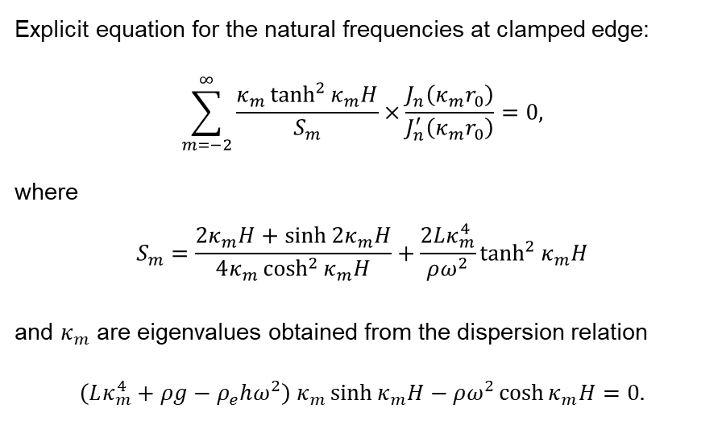
Circular cylindrical tank case
Vertical mode expansions:
Explicit equation for the natural frequencies at clamped edge:
$$\sum_{m=−2}^{∞}{\frac{κ_{m}\tanh^{2}{κ_{m}H}}{S_{m}}×\frac{J_{n}\left(κ_{m}r_{0}\right)}{J_{n}^{′}\left(κ_{m}r_{0}\right)}}=0,$$
where
$$S_{m}=\frac{2κ_{m}H+\sinh{2κ_{m}H}}{4κ_{m}\cosh^{2}{κ_{m}H}}+\frac{2Lκ_{m}^{4}}{ρω^{2}}\tanh^{2}{κ_{m}H}$$
and $κ_{m}$ are eigenvalues obtained from the dispersion relation
$$\left(Lκ_{m}^{4}+ρg−ρ_{e}hω^{2}\right) κ_{m}\sinh{κ_{m}H}−ρω^{2}\cosh{κ_{m}H}=0.$$

Slide 18
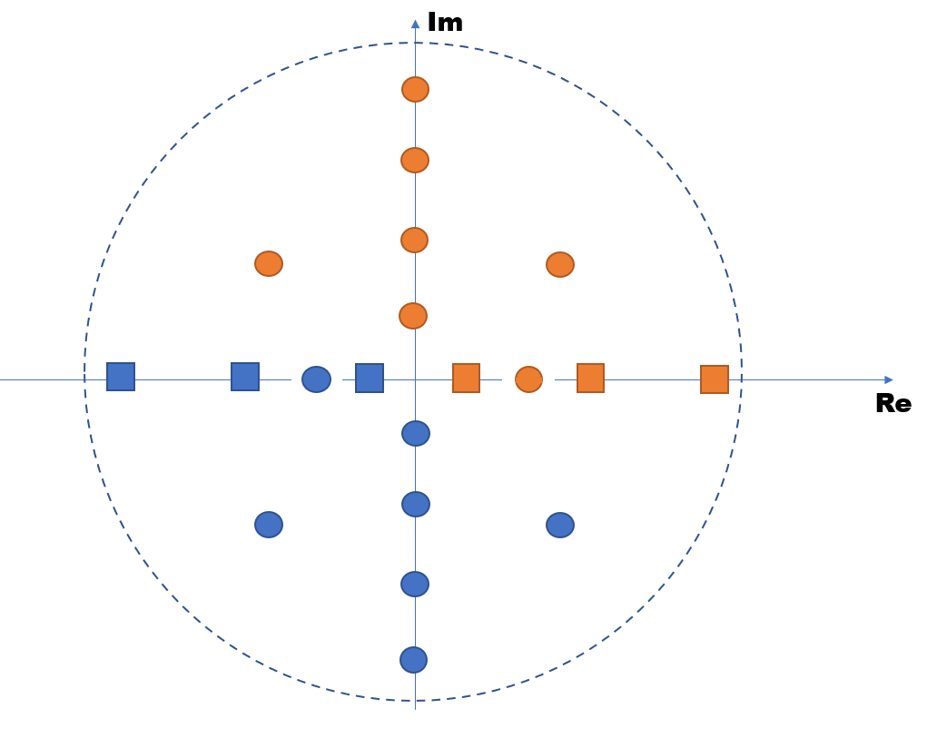
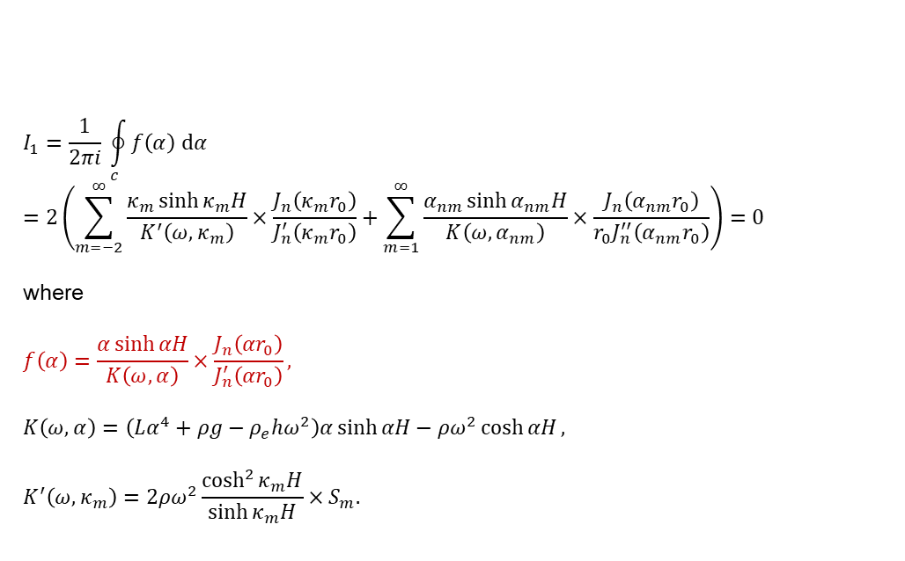
Circular cylindrical tank case
Residual theorem
$$I_{1}=\frac{1}{2πi} \oint_{c}^{ }{f\left(α\right) dα}=2\left(\sum_{m=−2}^{∞}{\frac{κ_{m}\sinh{κ_{m}H}}{K^{′}\left(ω,κ_{m}\right)}×\frac{J_{n}\left(κ_{m}r_{0}\right)}{J_{n}^{′}\left(κ_{m}r_{0}\right)}}+\sum_{m=1}^{∞}{\frac{α_{nm}\sinh{α_{nm}H}}{K\left(ω,α_{nm}\right)}×\frac{J_{n}\left(α_{nm}r_{0}\right)}{r_{0}J_{n}^{′′}\left(α_{nm}r_{0}\right)}}\right)=0$$
where
$$f\left(α\right)=\frac{α\sinh{αH}}{K\left(ω,α\right)}×\frac{J_{n}\left(αr_{0}\right)}{J_{n}^{′}\left(αr_{0}\right)},$$
$$K\left(ω,α\right)=\left(Lα^{4}+ρg−ρ_{e}hω^{2}\right)α\sinh{αH}−ρω^{2}\cosh{αH},$$
$$K^{′}\left(ω,κ_{m}\right)=2ρω^{2}\frac{\cosh^{2}{κ_{m}H}}{\sinh{κ_{m}H}}×S_{m}.$$
Note: Although the two equations obtained based on vertical mode expansion and Bessel-Fourier expansion look very different in form, we have proved that they are in fact identical through the residual theorem.

Slide 19



Fluid/Plate Interaction in Confined Regions
Circular cylindrical tank case
Natural frequencies
$$(a). n=0$$
$$(b). n=1$$
$$(c). n=2$$
Figure 1. The first four natural frequencies against different $H^{∗}$for various edge conditions for $L^{∗}=2×{10}^{−3}, m^{∗}=1×{10}^{−3}, ν=0.3$. Clamped edge: red circles; Simply supported edge: blue diamonds; Free edge: green squares. Results from Bauer (1995) for clamped edge are nondimensionalized and shown as black dashed lines for comparison in (a), (b) and (c).

Slide 20
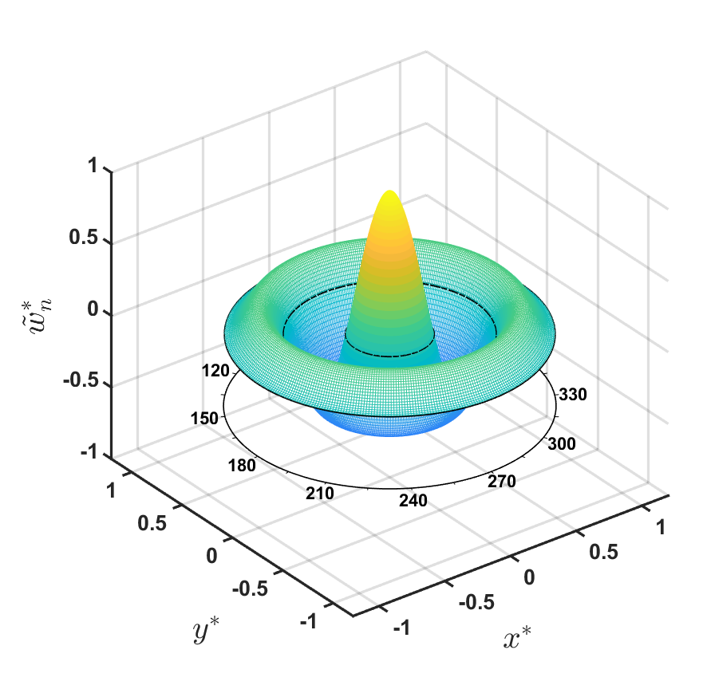
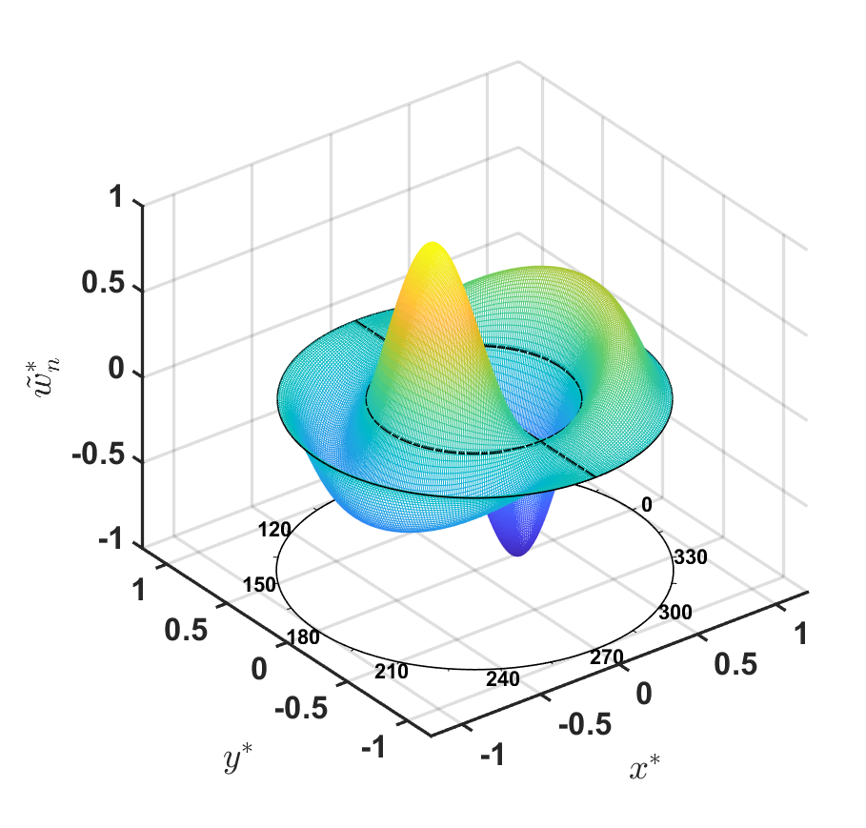
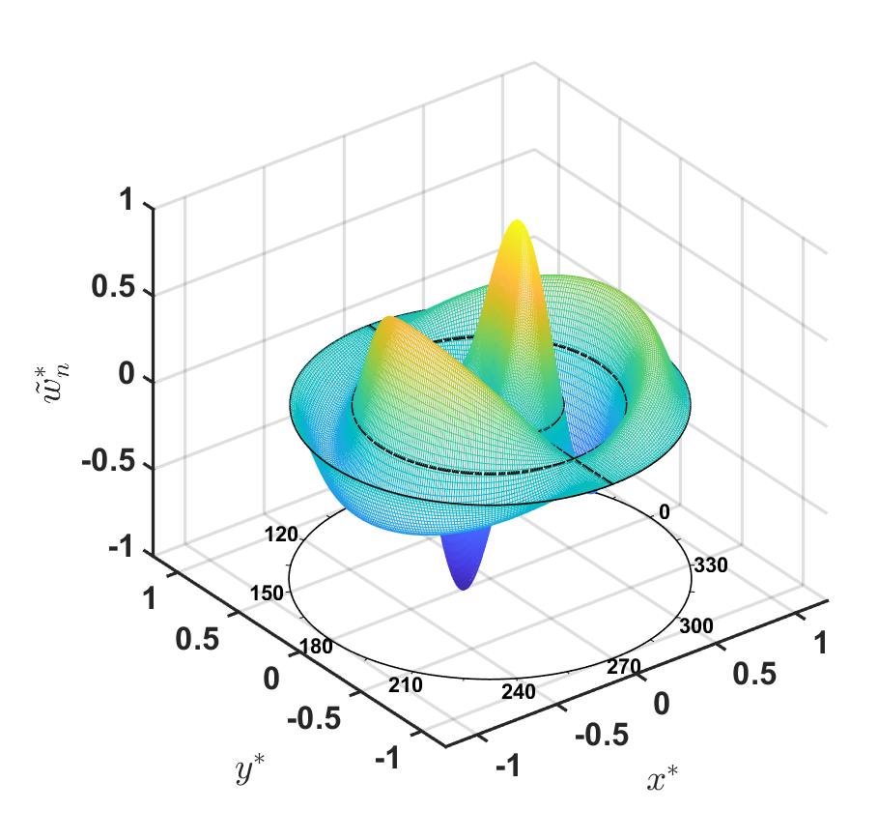
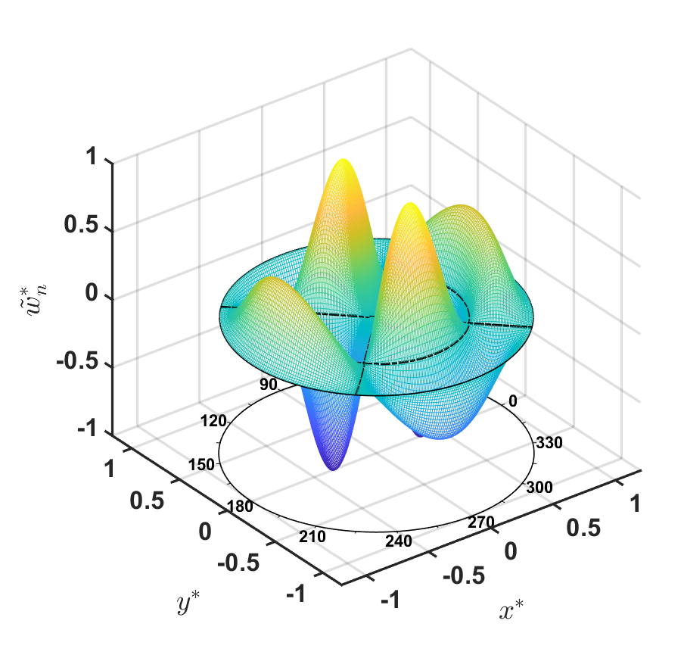
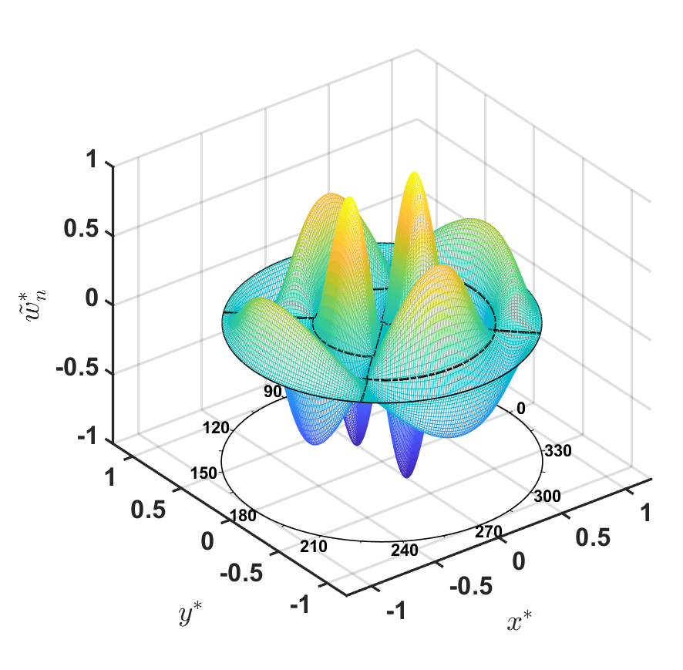
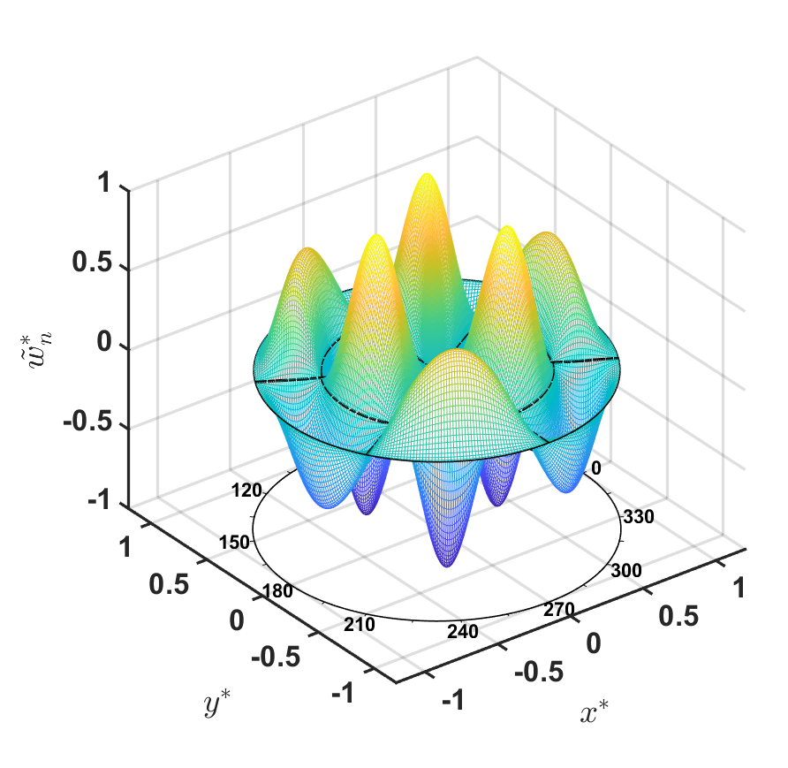


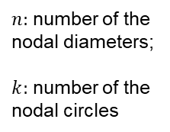




Circular cylindrical tank case
Mode shapes
$n:$ number of the nodal diameters;
$k:$ number of the nodal circles
$$\left(a\right). \left(n,k\right)=\left(0,3\right)$$
$$\left(b\right). \left(n,k\right)=\left(1,2\right)$$
$$\left(c\right). \left(n,k\right)=\left(1,3\right)$$
$$\left(d\right). \left(n,k\right)=\left(2,2\right)$$
$$\left(e\right). \left(n,k\right)=\left(2,3\right)$$
$$\left(f\right). \left(n,k\right)=\left(3,2\right)$$
Figure 2. Normalized mode shapes for clamped edge with $H^{∗}=1$ at mode $\left(n,k\right)$. $L^{∗}=2×{10}^{−3}, m^{∗}=1×{10}^{−3}, ν=0.3$.

Slide 21
Cubic tank case
Circular cylindrical tank | Cubic tank
no coupling among different circumferential modes | modes are usually coupled
polar coordinate system | Cartesian coordinate system
Velocity potential: Bessel-Fourier series in horizontal directions | Velocity potential: double cosine series in the horizontal directions
Cover deflection: same as the velocity potential. | Cover deflection: a).double cosine series + b). four additional terms in each direction (e.g., polynomial functions).
Natural frequencies: explicit equations are derived. | Natural frequencies: the truncated coefficient matrix is singular (based on a Gaussian elimination algorithm).
* Calculating the determinant directly becomes impractical when matrix size become very large
K. Ren, G.X. Wu, and Z.F. Li. "Natural modes of liquid sloshing in a cylindrical container with an elastic cover." J. Sound Vib. 512, 116390 (2021).
K. Ren, G.X. Wu, and Y.F. Yang. "Coupled Free Vibrations of Liquid in a Three-Dimensional Rectangular Container with an Elastic Cover." Phys. Fluids, 34, 067109 (2022)

Slide 22
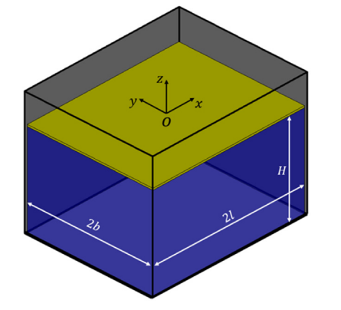
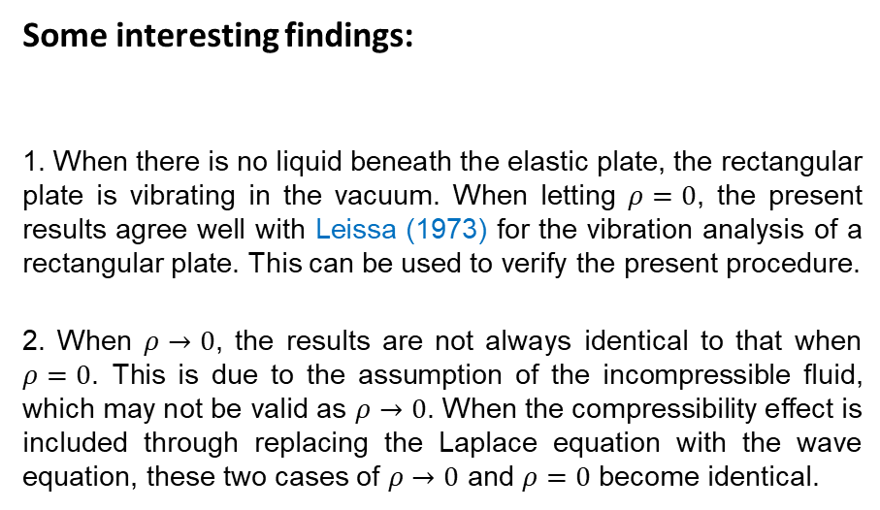
Cubic tank case
Some interesting findings:
1. When there is no liquid beneath the elastic plate, the rectangular plate is vibrating in the vacuum. When letting $ρ=0$, the present results agree well with Leissa (1973) for the vibration analysis of a rectangular plate. This can be used to verify the present procedure.
2. When $ρ→0$, the results are not always identical to that when $ρ=0$. This is due to the assumption of the incompressible fluid, which may not be valid as $ρ→0$. When the compressibility effect is included through replacing the Laplace equation with the wave equation, these two cases of $ρ→0$ and $ρ=0$ become identical.
A. W. Leissa, “ The free vibration of rectangular plate,” J. Sound Vib. 31, 257–293 (1973)
K. Ren, G.X. Wu, and Y.F. Yang. "Coupled Free Vibrations of Liquid in a Three-Dimensional Rectangular Container with an Elastic Cover." Phys. Fluids, 34, 067109 (2022)

Slide 23
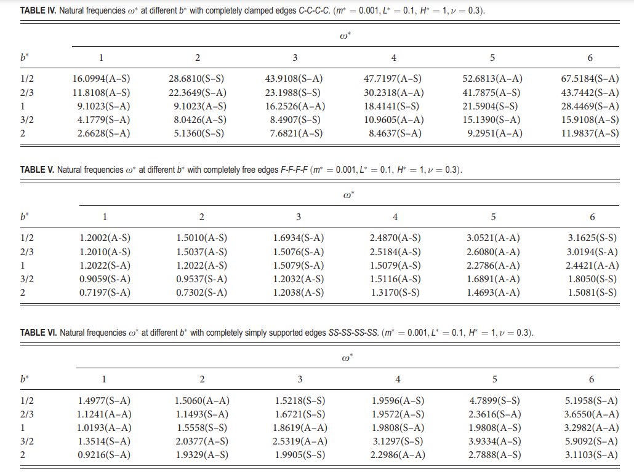
Cubic tank case
Natural frequencies

Slide 24
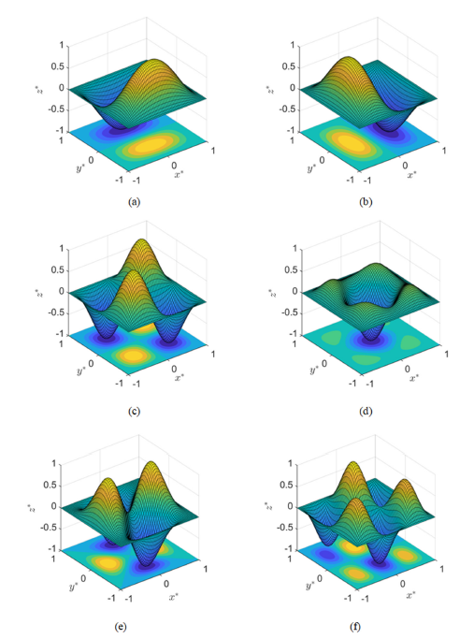
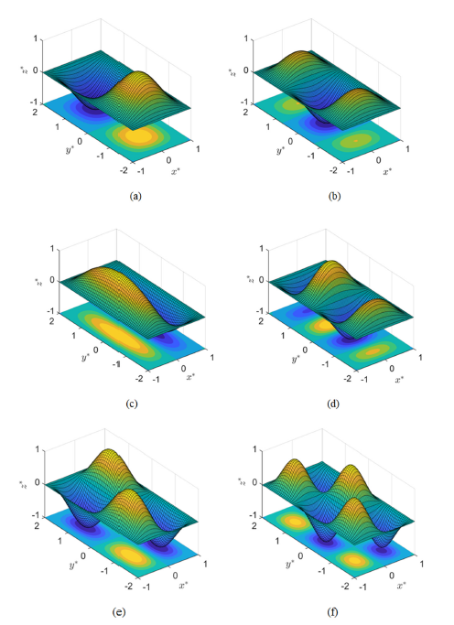
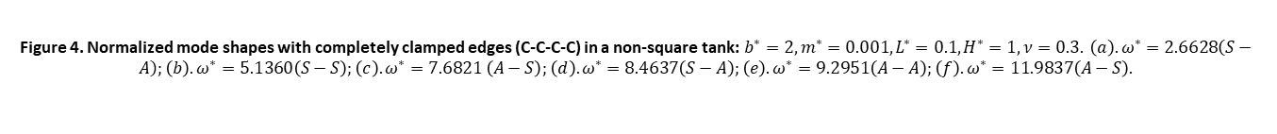
Cubic tank case
Mode shapes
When the cover has same type of edges on its four sides, the natural modes can be split into four mode groups, which are uncoupled from each other, with mode shapes either symmetric (S) or antisymmetric (A) with respect to the longitudinal and transverse directions, namely, S-S, A-S, S-A, and A-A.
Figure 3. Normalized mode shapes with completely clamped edges (C-C-C-C) in a square tank: $b^{∗}=1, m^{∗}=0.001, L^{∗}=0.1, H^{∗}=1, ν=0.3. \left(a\right). ω^{∗}=9.1023\left(S−A\right);\left(b\right). ω^{∗}=9.1023\left(A−S\right);\left(c\right). ω^{∗}=16.2526 \left(A−A\right);\left(d\right). ω^{∗}=18.4141\left(S−S\right);\left(e\right). ω^{∗}=21.5904\left(S−S\right);\left(f\right). ω^{∗}=28.4469\left(S−A\right).$
Figure 4. Normalized mode shapes with completely clamped edges (C-C-C-C) in a non-square tank: $b^{∗}=2, m^{∗}=0.001, L^{∗}=0.1, H^{∗}=1, ν=0.3. \left(a\right). ω^{∗}=2.6628\left(S−A\right);\left(b\right). ω^{∗}=5.1360\left(S−S\right);\left(c\right). ω^{∗}=7.6821 \left(A−S\right);\left(d\right). ω^{∗}=8.4637\left(S−A\right);\left(e\right). ω^{∗}=9.2951\left(A−A\right);\left(f\right). ω^{∗}=11.9837\left(A−S\right).$

Slide 25
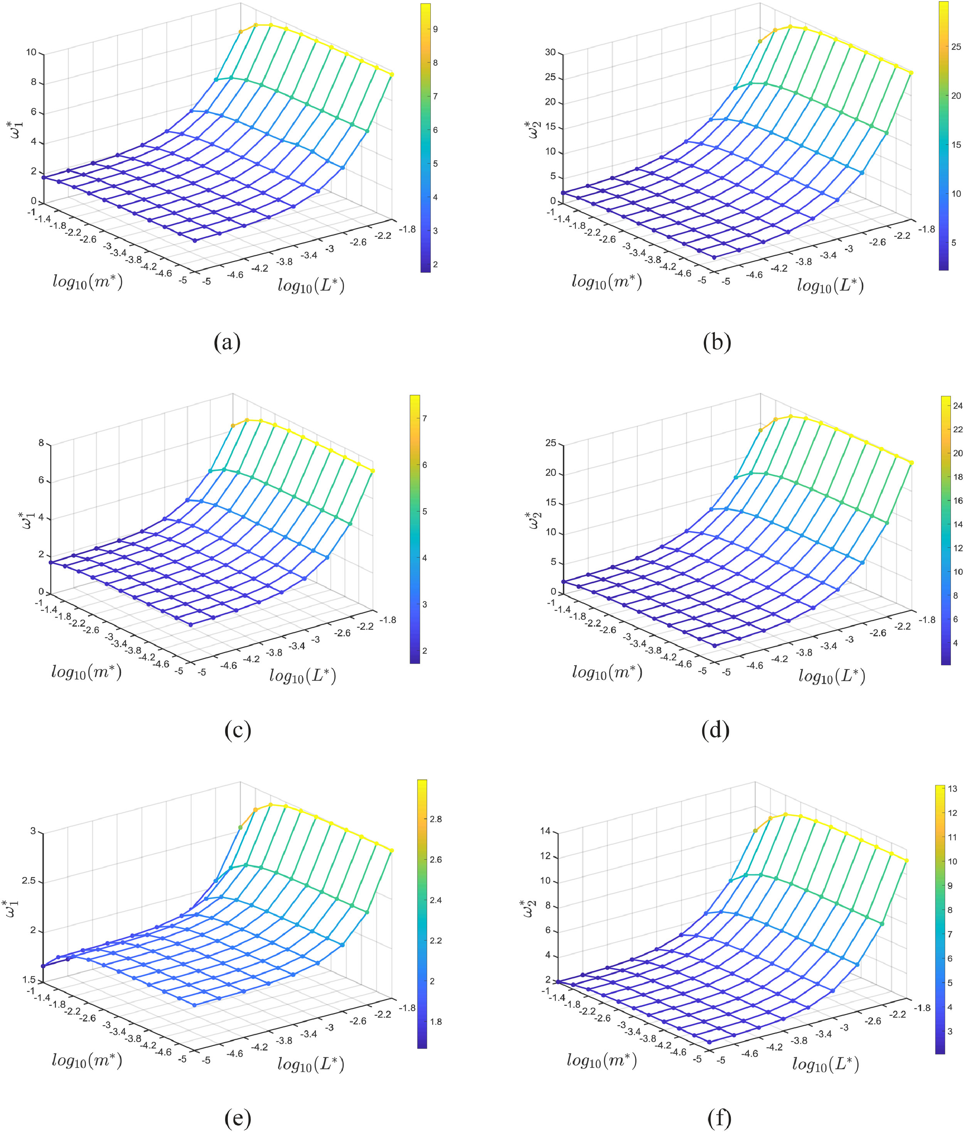
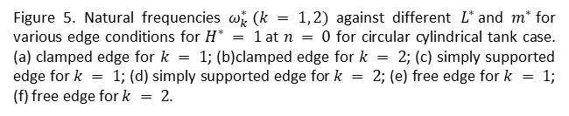
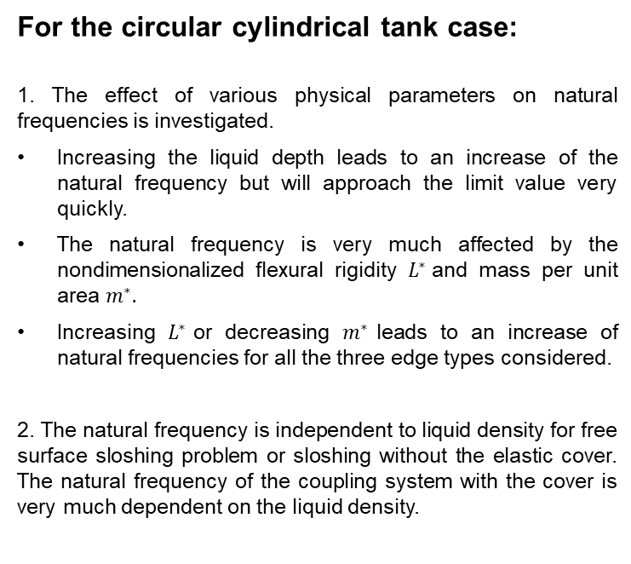
Conclusions
For the circular cylindrical tank case:
1. The effect of various physical parameters on natural frequencies is investigated.
Increasing the liquid depth leads to an increase of the natural frequency but will approach the limit value very quickly.
The natural frequency is very much affected by the nondimensionalized flexural rigidity $L^{∗}$and mass per unit area $m^{∗}.$
Increasing $L^{∗}$or decreasing $m^{∗}$leads to an increase of natural frequencies for all the three edge types considered.
2. The natural frequency is independent to liquid density for free surface sloshing problem or sloshing without the elastic cover. The natural frequency of the coupling system with the cover is very much dependent on the liquid density.
Figure 5. Natural frequencies $ω_{k}^{∗} (k = 1, 2)$ against different $L^{∗}$and $m^{∗}$for various edge conditions for $H^{∗} = 1$at $n = 0$ for circular cylindrical tank case. (a) clamped edge for $k = 1$; (b)clamped edge for $k = 2$; (c) simply supported edge for $k = 1$; (d) simply supported edge for $k = 2$; (e) free edge for $k = 1$; (f) free edge for $k = 2$.

Slide 26
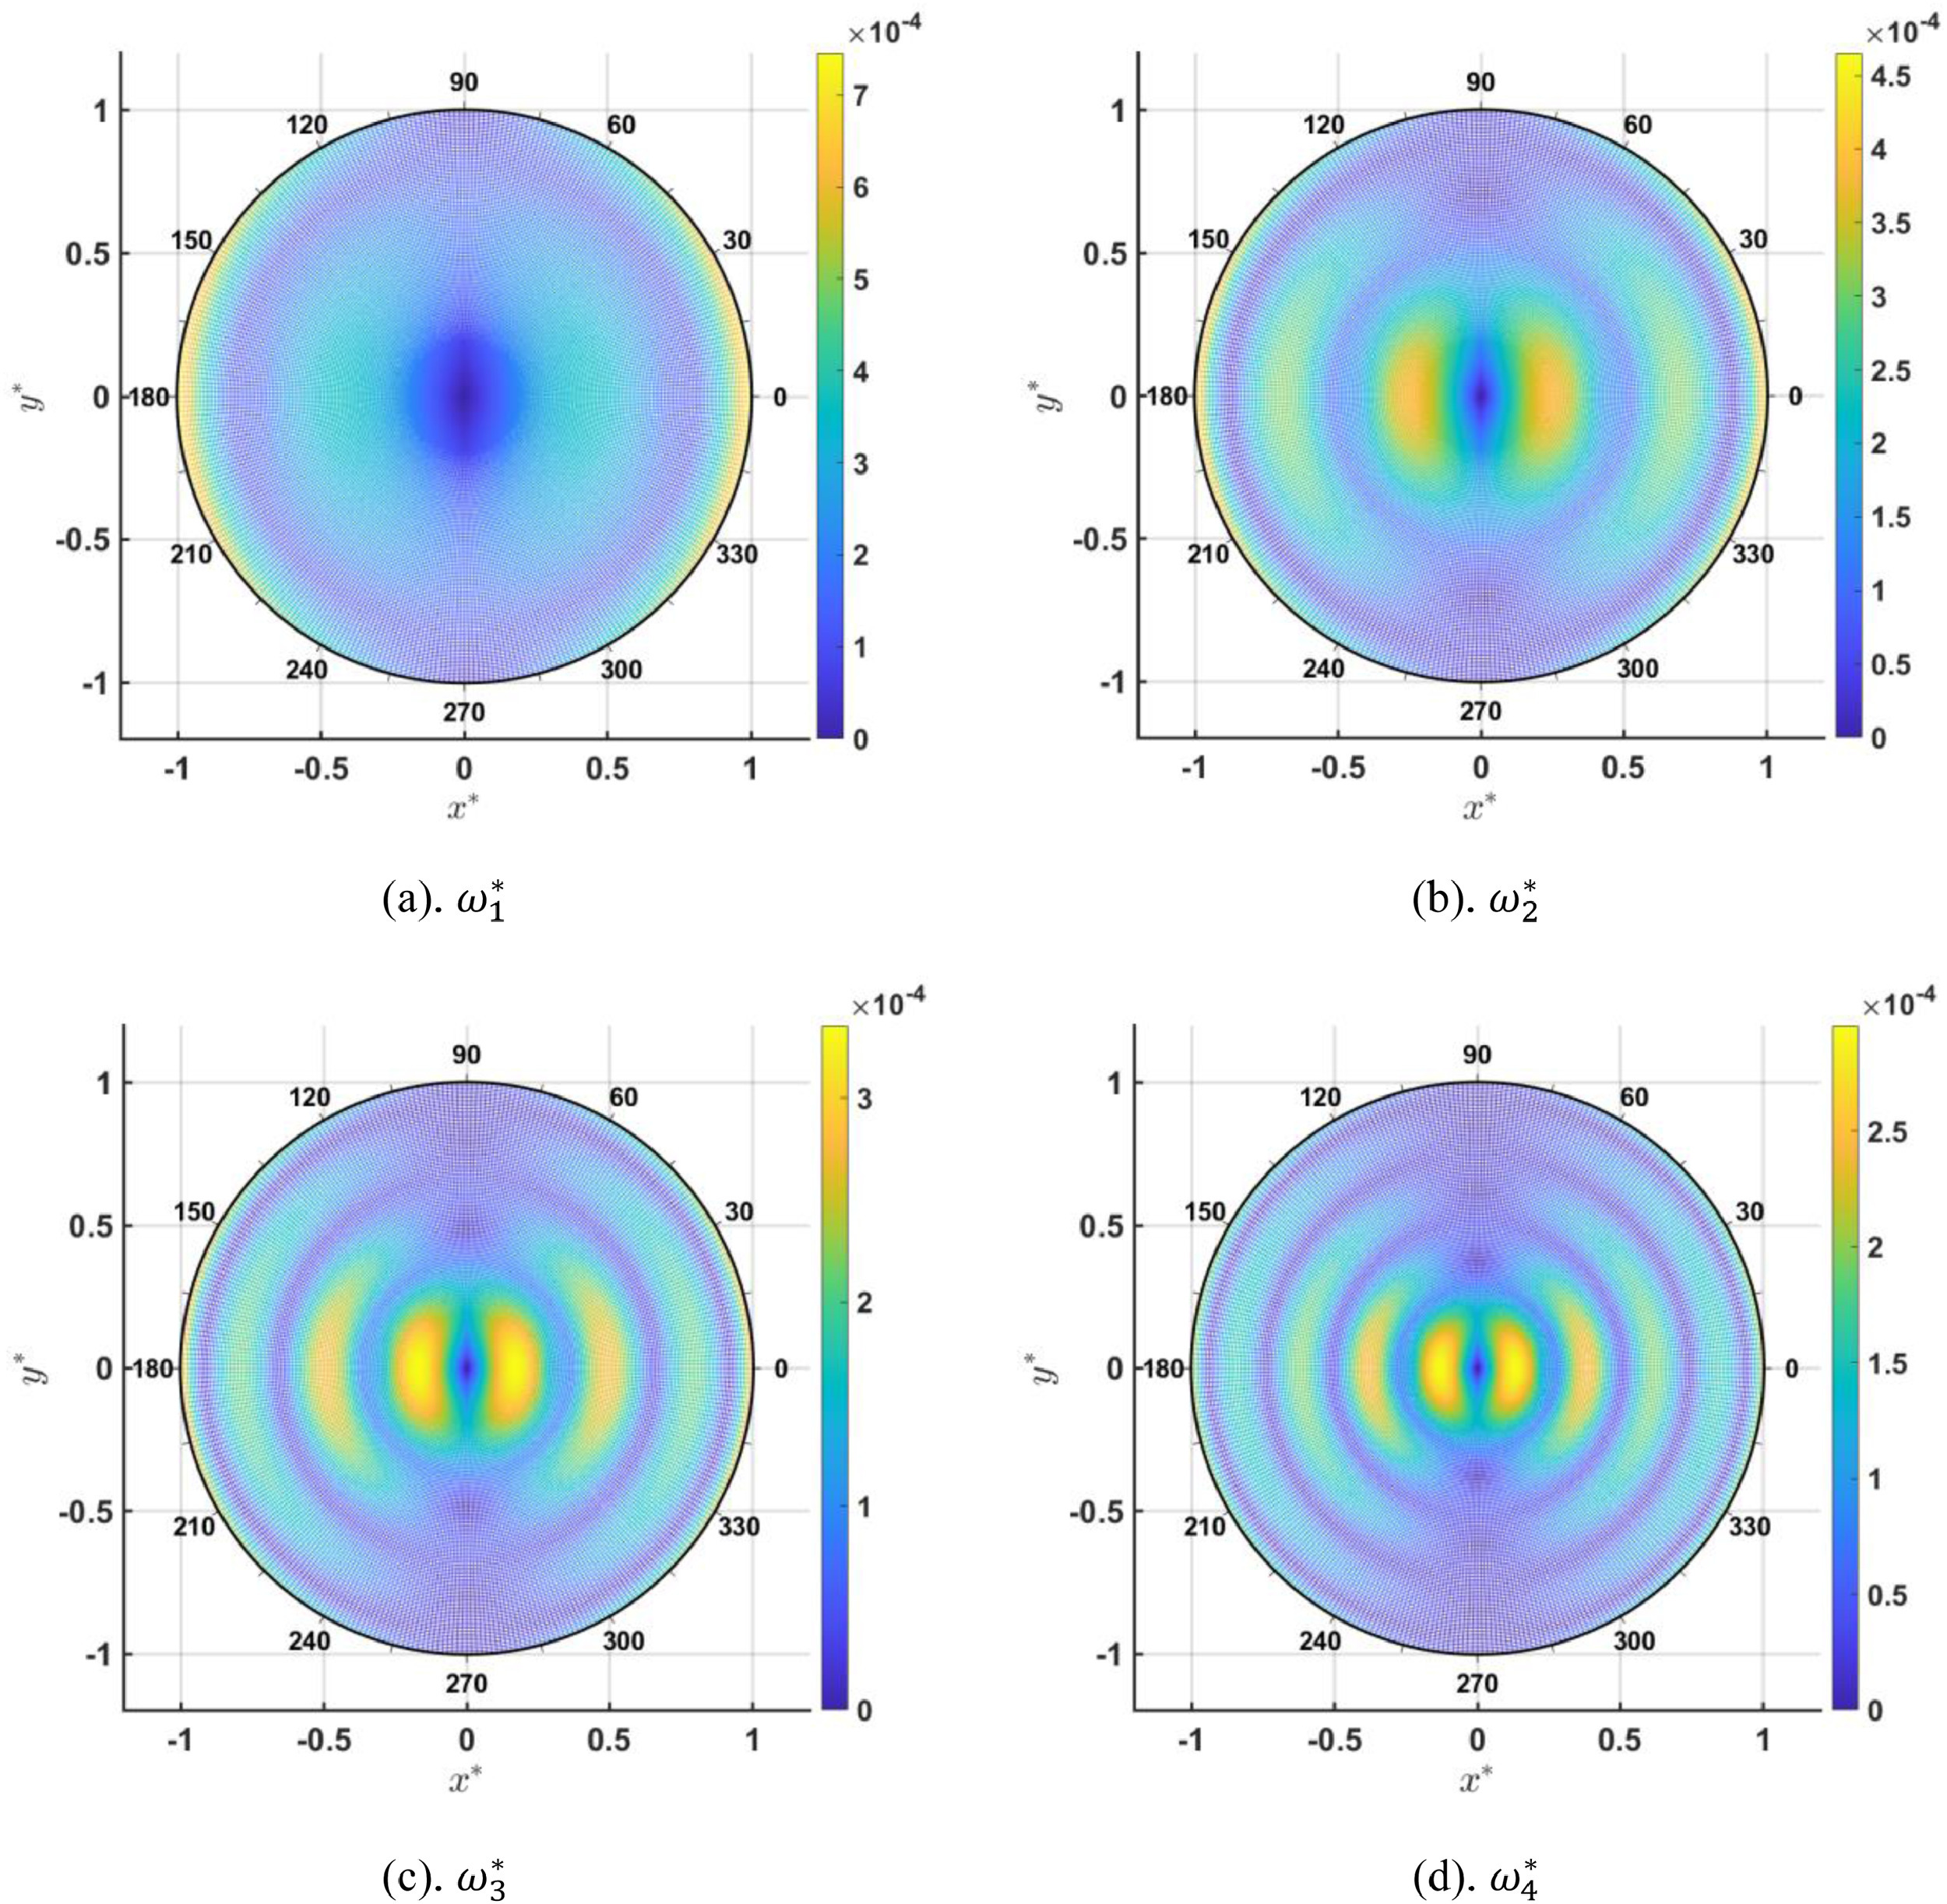
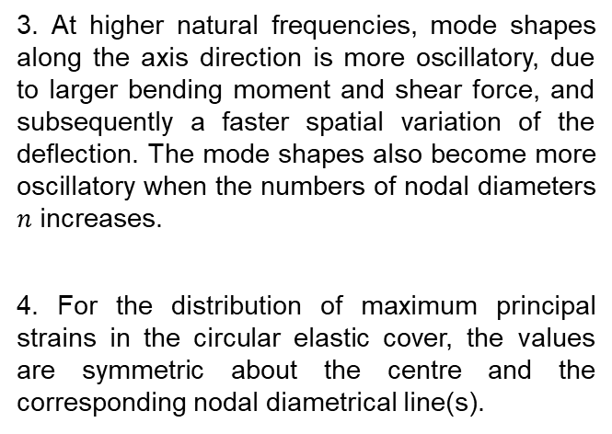
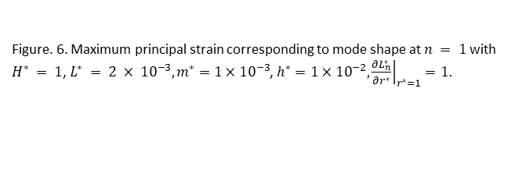
Conclusions
For the circular cylindrical tank case:
3. At higher natural frequencies, mode shapes along the axis direction is more oscillatory, due to larger bending moment and shear force, and subsequently a faster spatial variation of the deflection. The mode shapes also become more oscillatory when the numbers of nodal diameters $n$ increases.
4. For the distribution of maximum principal strains in the circular elastic cover, the values are symmetric about the centre and the corresponding nodal diametrical line(s).
Figure. 6. Maximum principal strain corresponding to mode shape at $n = 1$with $H^{∗} = 1$, $L^{∗} = 2 × {10}^{−3}, m^{∗}=1×{10}^{−3}$, $h^{∗}=1×{10}^{−2},{\left.\frac{∂L_{n}^{∗}}{∂r^{∗}}\right|}_{r^{∗}=1}=1.$

Slide 27
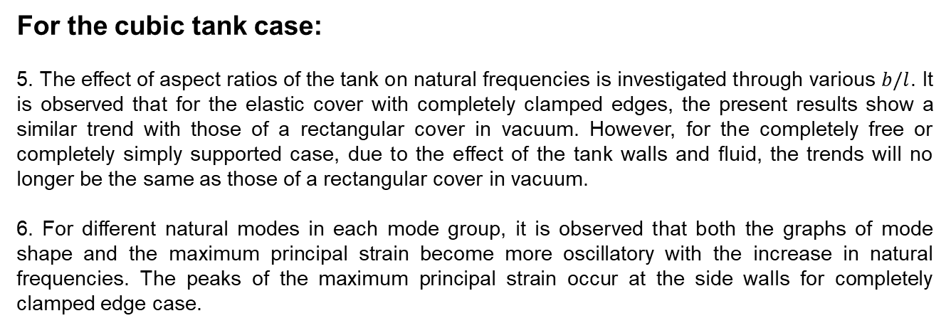
Conclusions
For the cubic tank case:
5. The effect of aspect ratios of the tank on natural frequencies is investigated through various $b/l$. It is observed that for the elastic cover with completely clamped edges, the present results show a similar trend with those of a rectangular cover in vacuum. However, for the completely free or completely simply supported case, due to the effect of the tank walls and fluid, the trends will no longer be the same as those of a rectangular cover in vacuum.
6. For different natural modes in each mode group, it is observed that both the graphs of mode shape and the maximum principal strain become more oscillatory with the increase in natural frequencies. The peaks of the maximum principal strain occur at the side walls for completely clamped edge case.

Slide 28
Thank you for your attention!

